Slide 1





EBS Pacific cod
BSAI Groundfish Plan Team
Steven Barbeaux, Jason Conner, Cecilia A. O’Leary, S. Kalei Shotwell, Elizabeth Siddon, Ingrid Spies, and James T. Thorson
November, 2022

Slide 2
Stock Overview
Tier: 3a
Area: Eastern Bering Sea (EBS) and Northern Bering Sea (NBS)
Current year status
BRIEF summary of changes to the current assessment data/model

Slide 3
Teams or SSC Comments
Given that an ensemble model structure has been endorsed by the SSC in 2021, representing a fairly large change in the assessment process, if the new authors choose to propose an ensemble in the future it may be prudent to minimize changes to the suite of models comprising the ensemble so that the potential benefits of a stable ensemble can be realized.
The authors presented a series of minor changes to the model this year. The Plan Team and SSC endorsed removing of the weight-at-length adjustments and the aging bias for post-2007. These model changes resulted in very minimal changes to the resulting model and are described in the document below.
Notes:
PT/SSC comments being addressed IN THIS PRESENTATION ONLY

Slide 4
Teams or SSC Comments
If model ensembles are brought forward in the future, the authors should work with the BSAI GPT to define a process whereby GPT members themselves assign model scores based on the same, or an updated set, of scoring criteria. This would allow for future development of ensemble member weightings based upon independent review, and the SSC believes this would address one of the concerns highlighted in public comment.
In light of the above recommendation, model changes were kept to a minimum and the weighting criteria used for this year’s ensemble were judged to rate the same as the weights generated by the CIE and endorsed by the SSC in 2021.
Notes:
PT/SSC comments being addressed IN THIS PRESENTATION ONLY

Slide 5
Teams or SSC Comments
The SSC recommends that inclusion of [fishery age composition data] be fully explored in a later assessment cycle, either within a single model or multiple ensemble members, highlighting that it views this as a top priority for future research.
Given the already monumental task of taking this stock over from Dr. Thompson, the authors chose not to investigate the use of fishery age composition data. This also in light of the SSCs recommendation to minimize changes to the suite of models comprising the ensemble. The authors intend to investigate the use of fishery age composition data in the future.
Notes:
PT/SSC comments being addressed IN THIS PRESENTATION ONLY

Slide 6
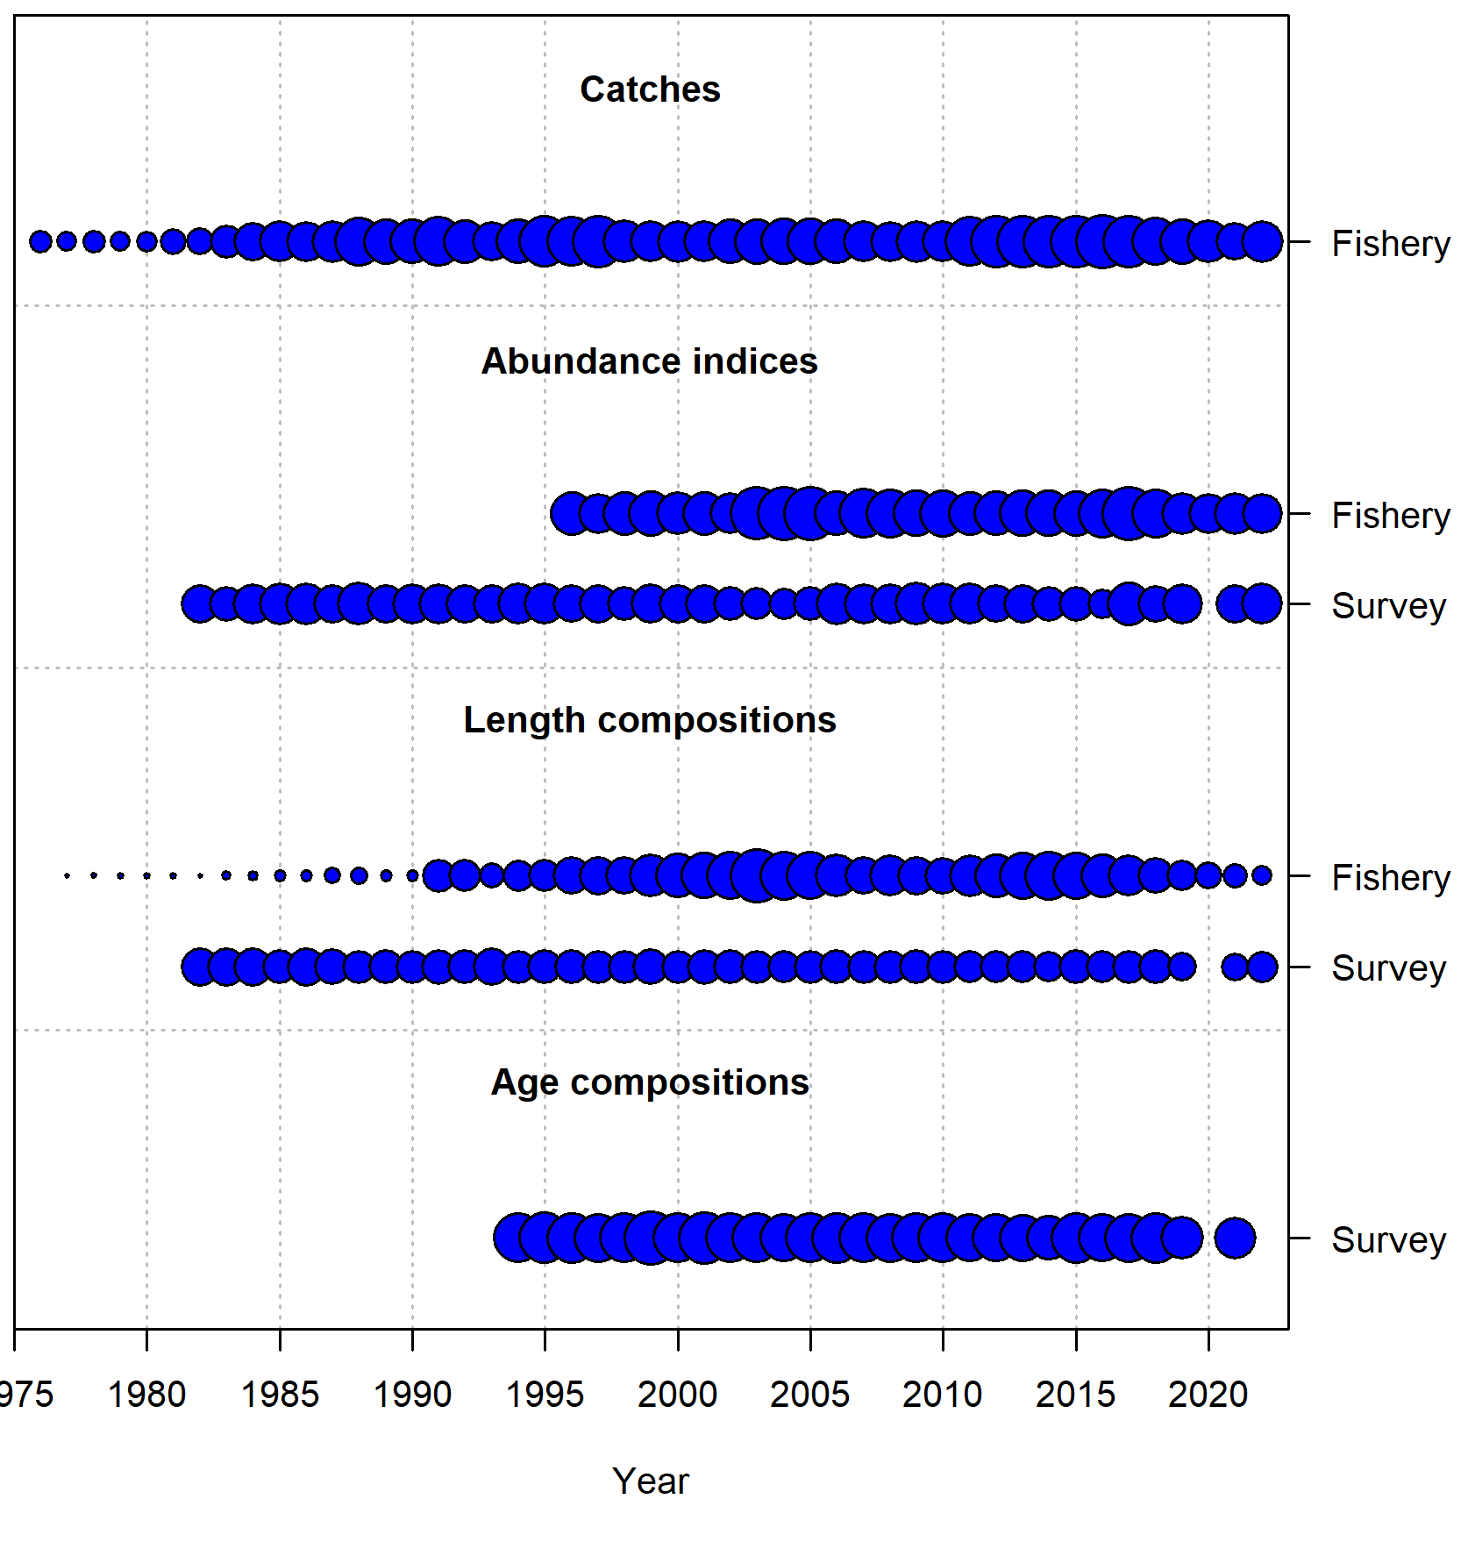
Data Summary
Source | Type |  | Years
Fishery |  | Catch biomass | 1977-2022
Fishery |  | Catch size composition | 1977-2022
Fishery |  | Catch per unit effort (VAST) | 1996-2022
EBS+NBS trawl survey |  | Survey numerical abundance (VAST) | 1982-2019, 2021-2022
EBS+NBS trawl survey |  | Survey age composition (VAST) | 1994-2019,2021
Notes:
Time series graph or table of data used in the model, specify years (try to avoid presenting data not used in the model unless presented to provide support for model evaluation)

Slide 7
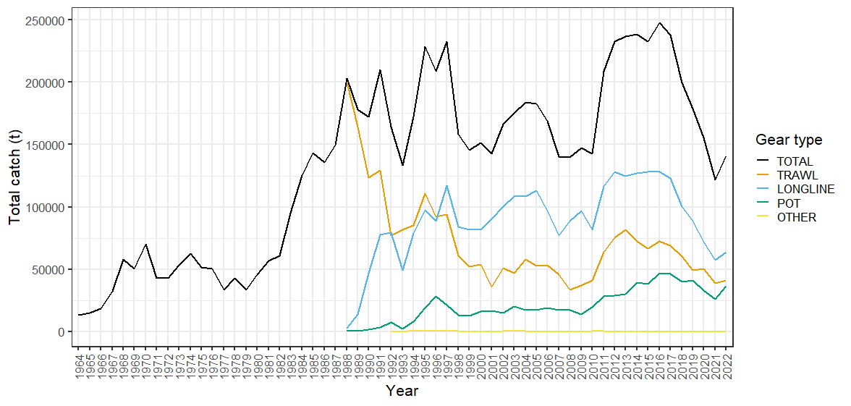
Catch
Notes:
Time series with highlights of trends and any issues (e.g., overages, data issues, discards), provide regional breakdown time series or spatial distribution maps only if relevant to data interpretation or model evaluation

Slide 8
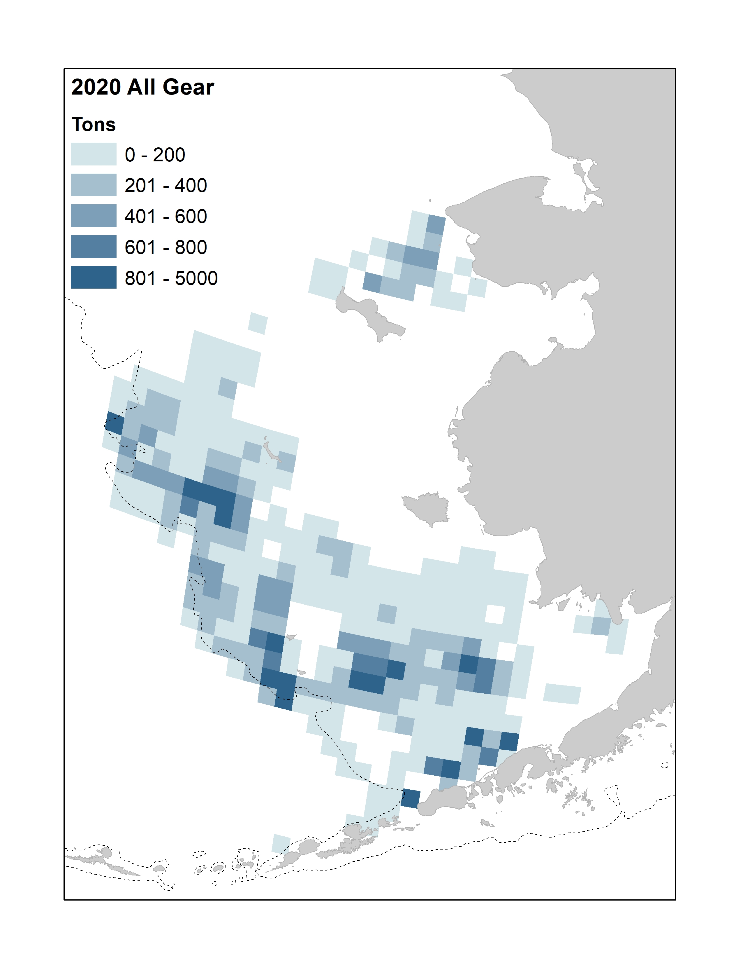
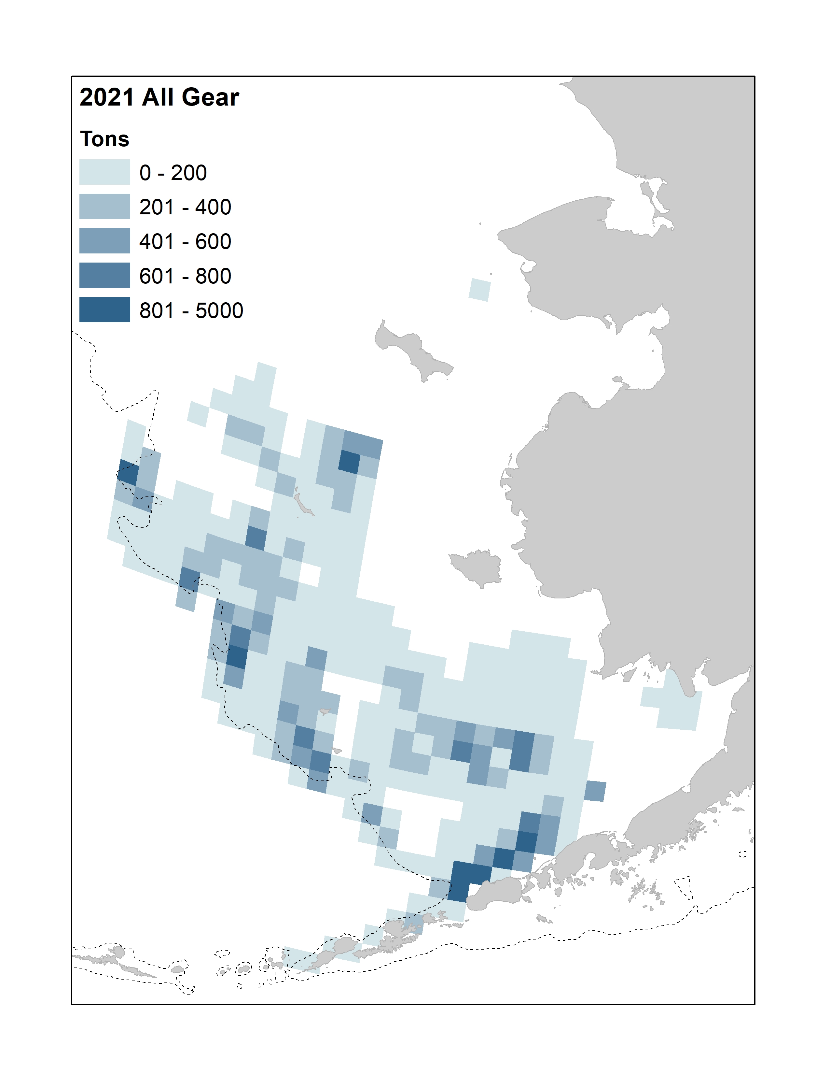
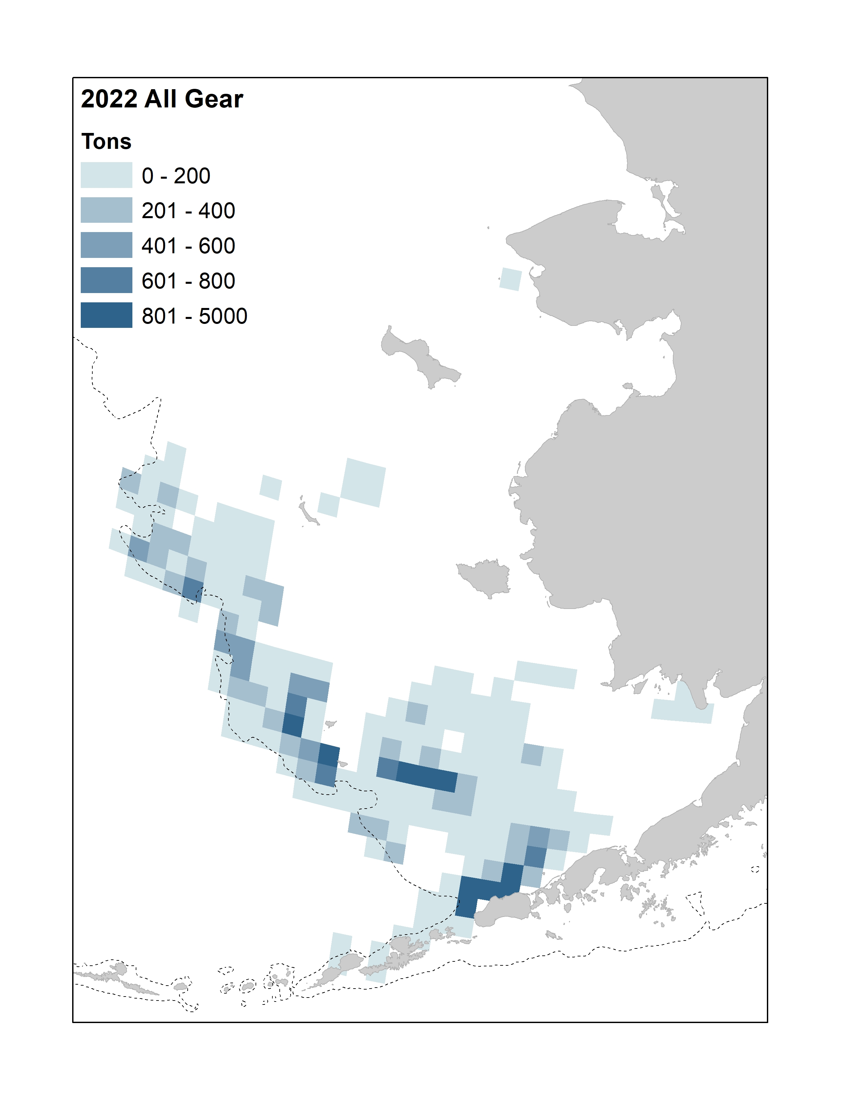
Catch
Through October 9, 2022
Notes:
Time series with highlights of trends and any issues (e.g., overages, data issues, discards), provide regional breakdown time series or spatial distribution maps only if relevant to data interpretation or model evaluation

Slide 9
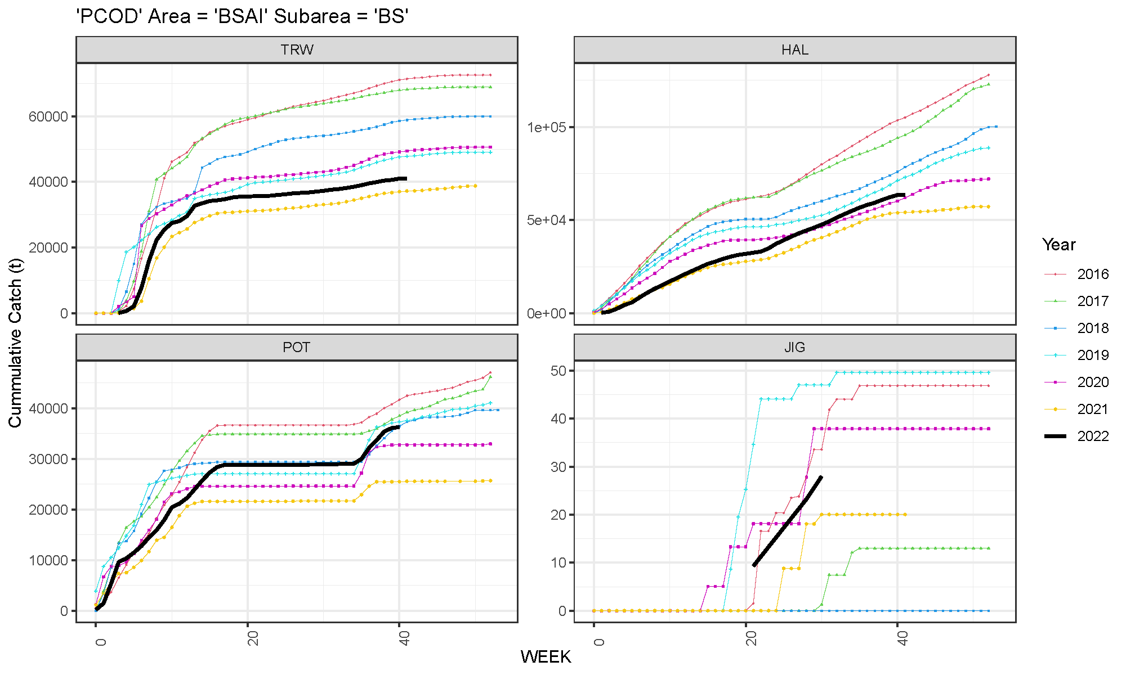
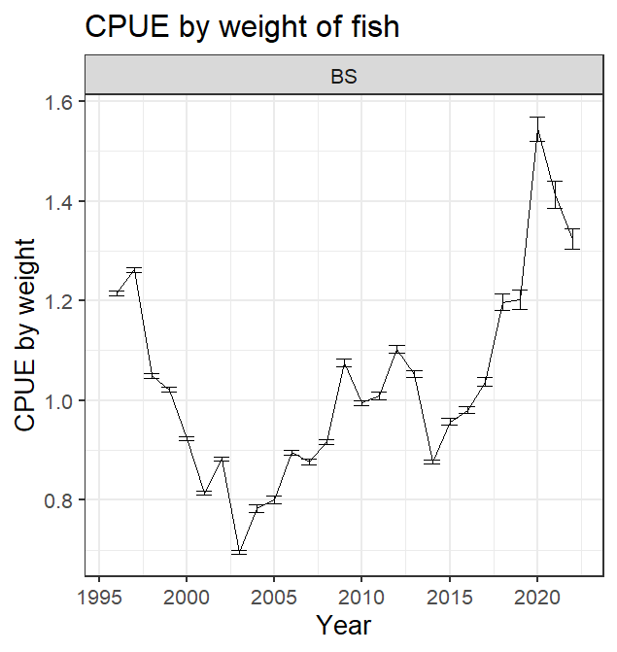
Catch
Notes:
Time series with highlights of trends and any issues (e.g., overages, data issues, discards), provide regional breakdown time series or spatial distribution maps only if relevant to data interpretation or model evaluation

Slide 10
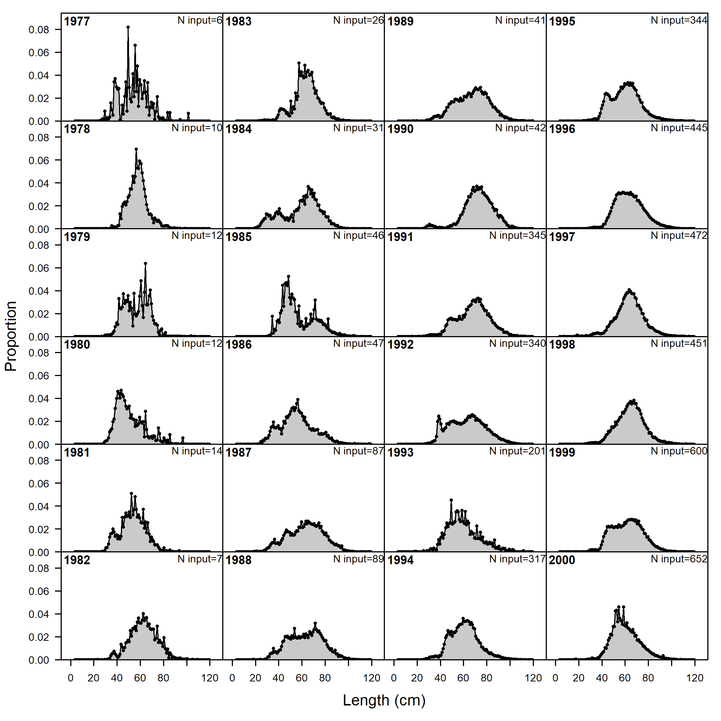
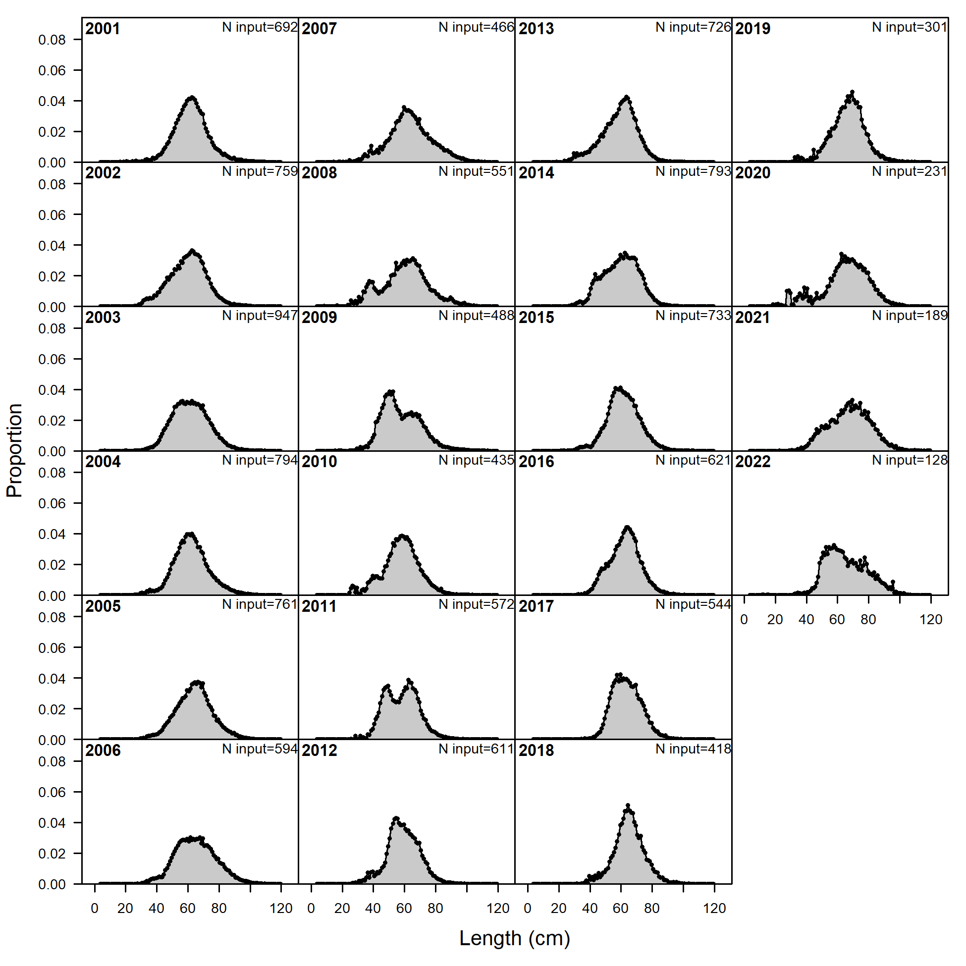
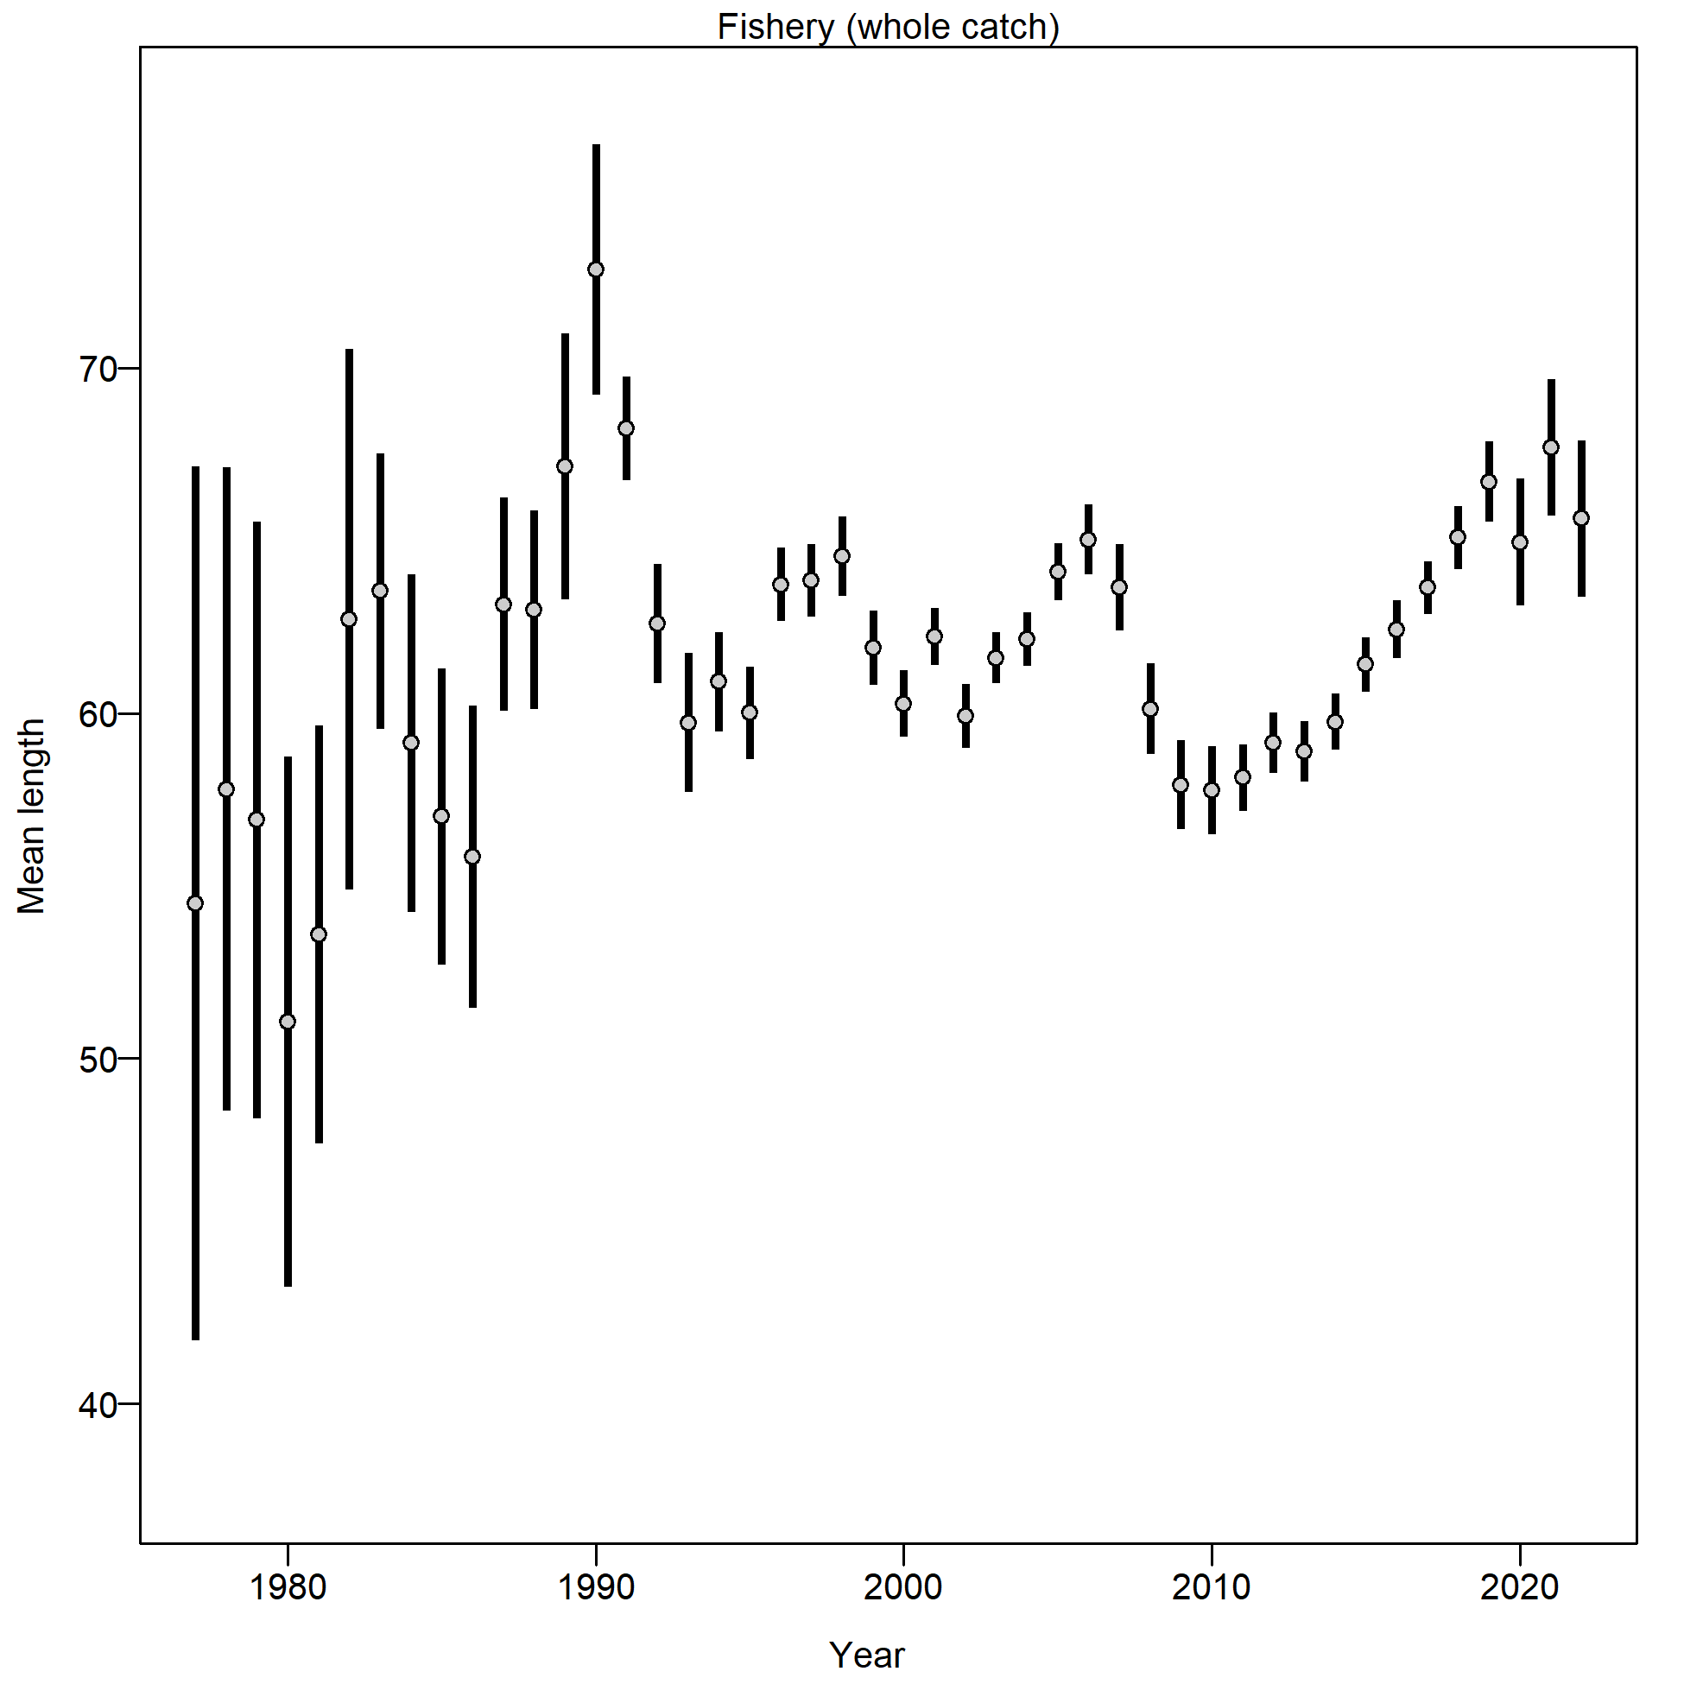
Fishery Size Composition
Notes:
Graphs of age compositions by sex (if relevant) over time followed by size compositions by sex (if relevant) over time with highlights of trends and any issues (e.g., tracking cohorts through time, shifts in size distributions, plus age group)

Slide 11
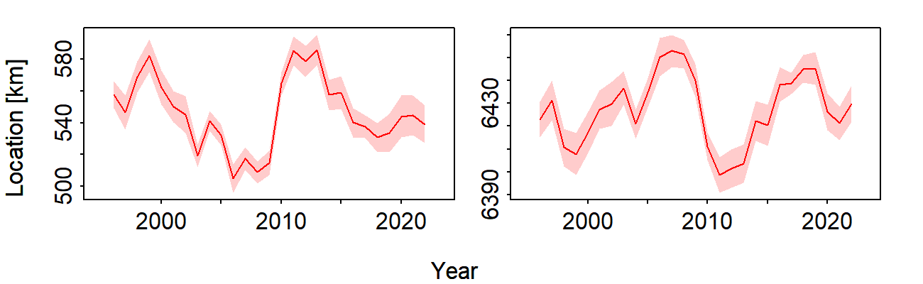
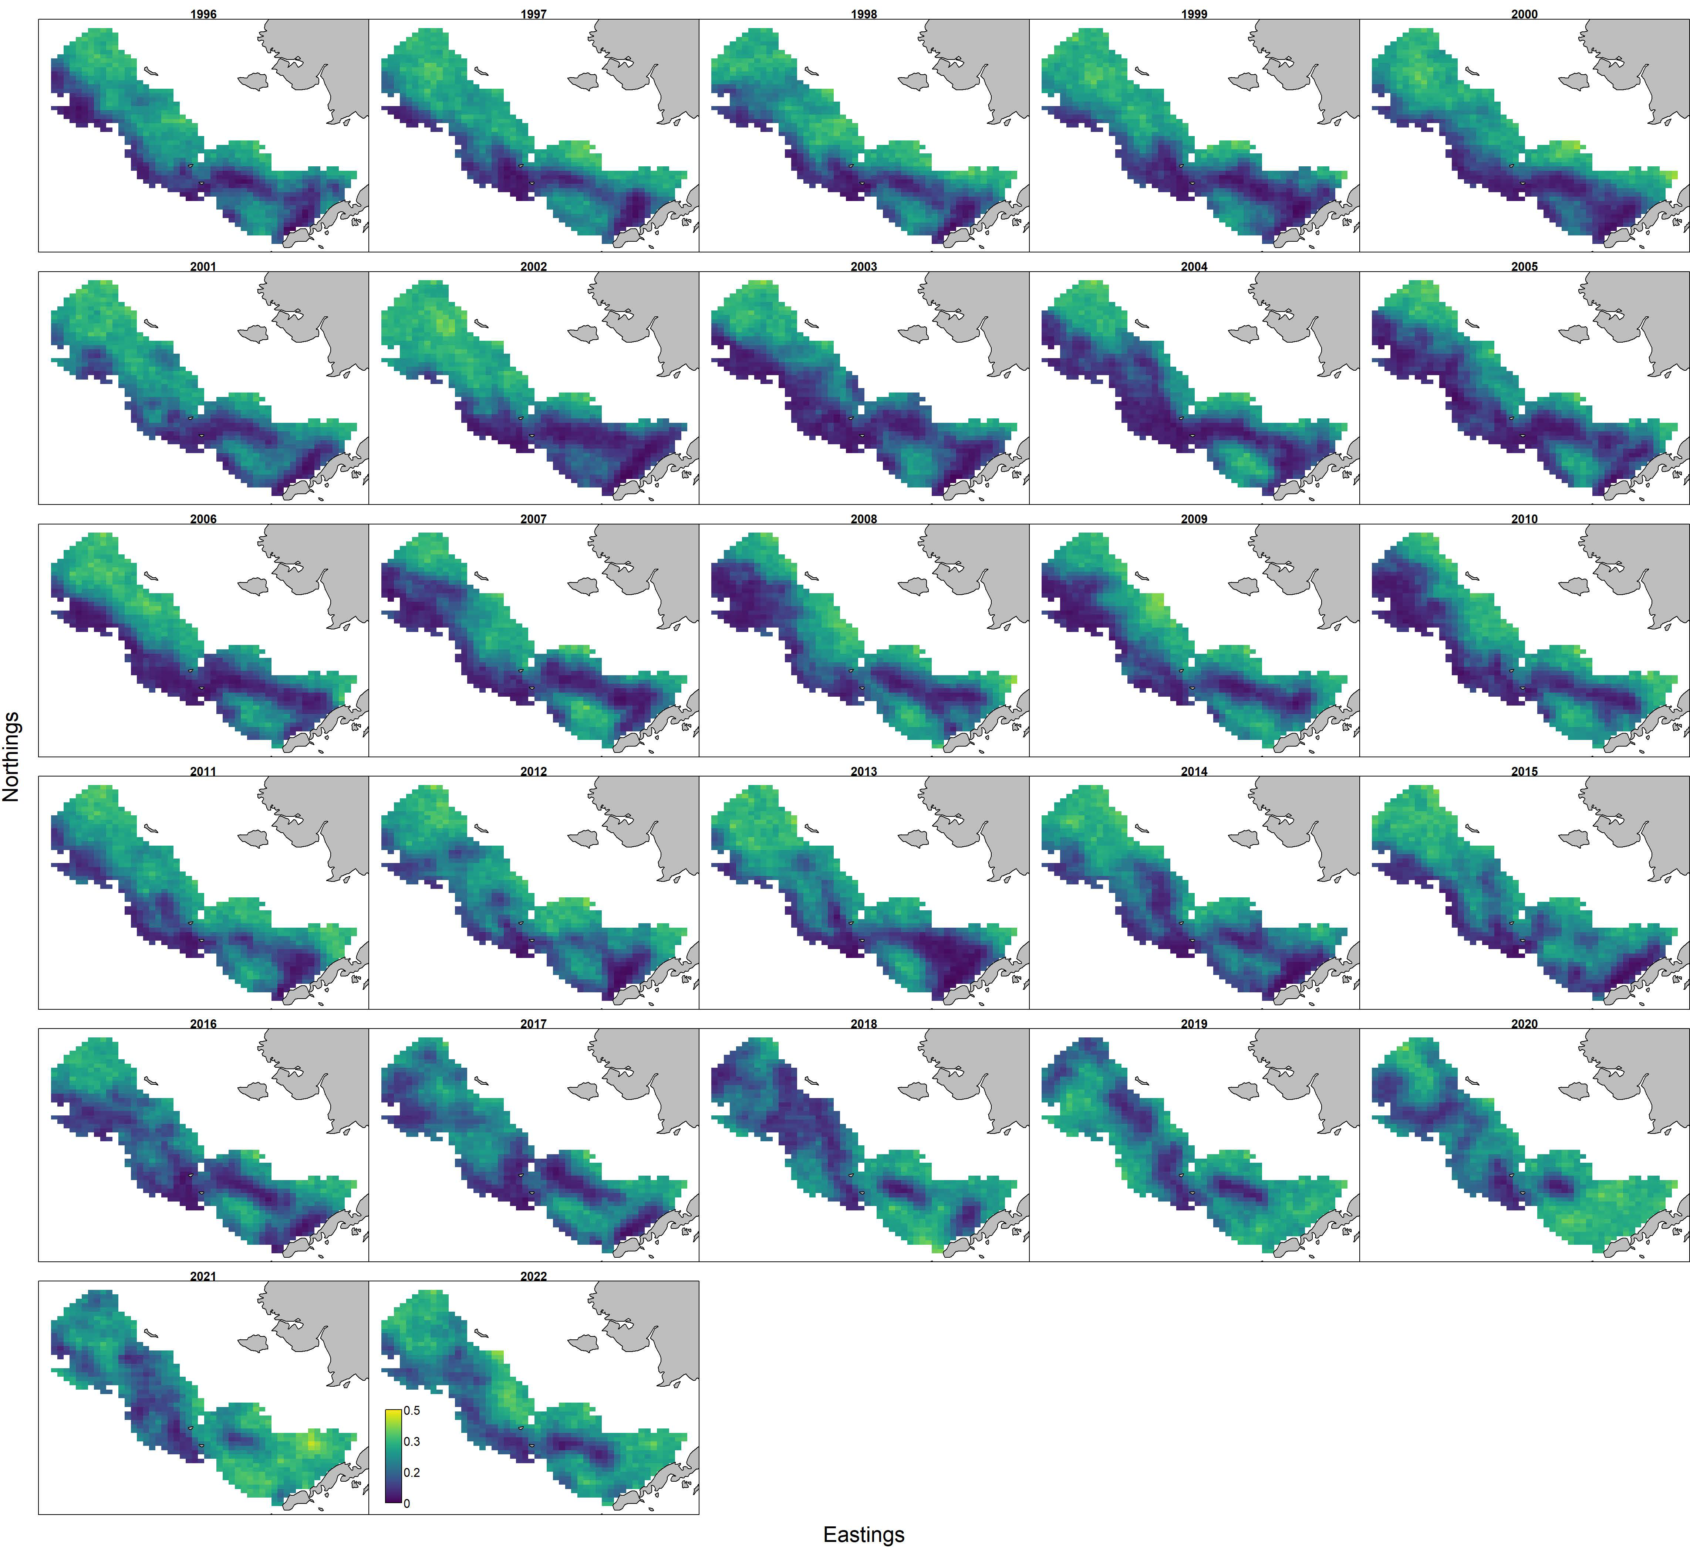
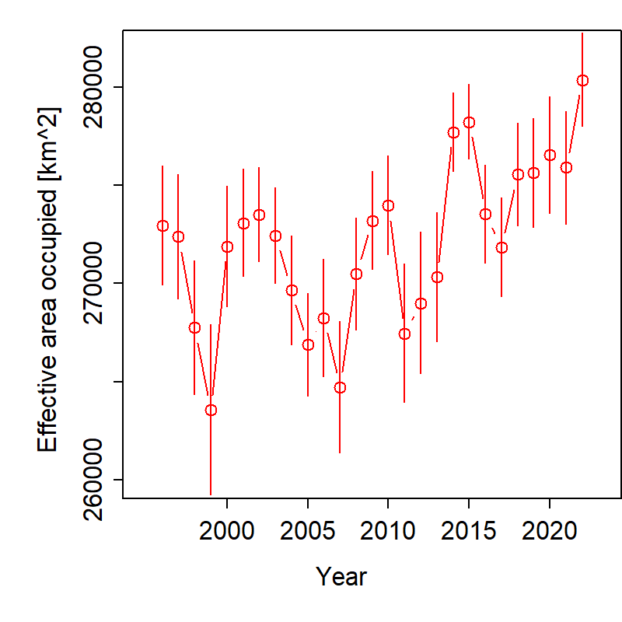
VAST CPUE Index – Jan-Feb Longline Fishery
Eastings (km)
Northings (km)
COG shifted to the northwest since 2021
Overall extent has continued to increase
Notes:
Time series with highlights of trends and any issues (e.g., survey method changes, data issues), use separate slides for different survey time series, provide regional breakdown time series or spatial distribution maps only if relevant to data interpretation or model evaluation, may include exploratory surveys if relevant to model interpretation, otherwise limit

Slide 12
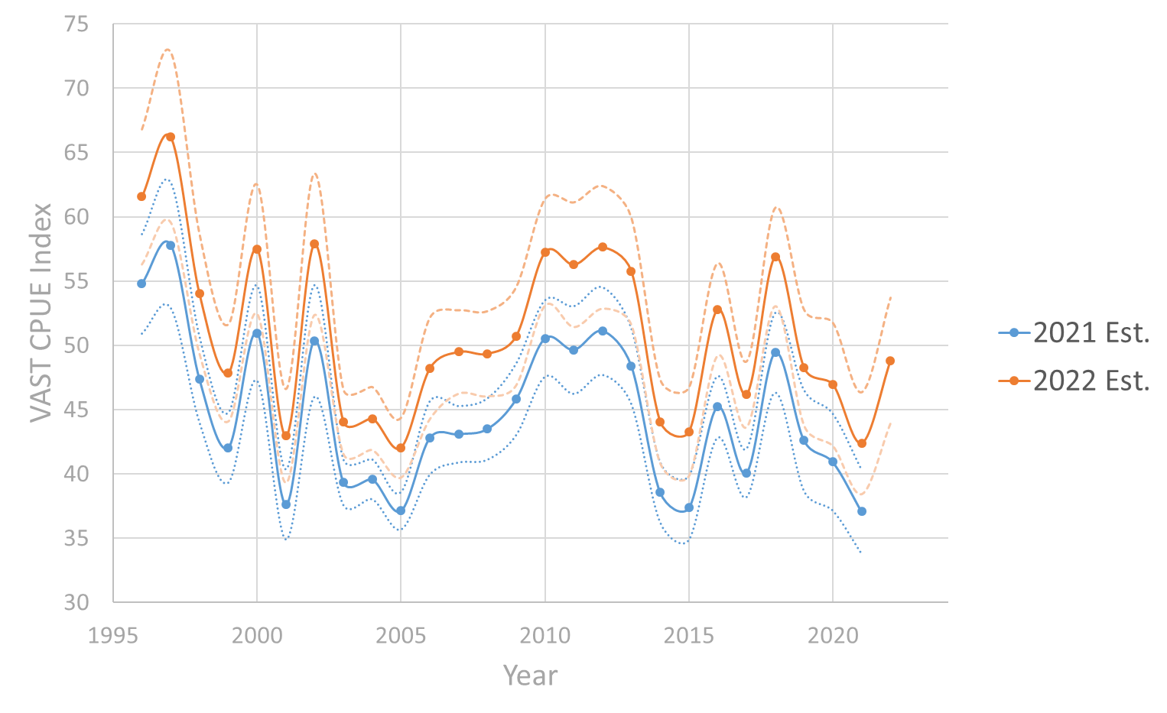
VAST CPUE Index – Jan.-Feb. Longline Fishery
Difference in methods resulted in overall inflation of index
Trend remains the same
15% Increase in 2022 from 2021
Notes:
Time series with highlights of trends and any issues (e.g., survey method changes, data issues), use separate slides for different survey time series, provide regional breakdown time series or spatial distribution maps only if relevant to data interpretation or model evaluation, may include exploratory surveys if relevant to model interpretation, otherwise limit

Slide 13
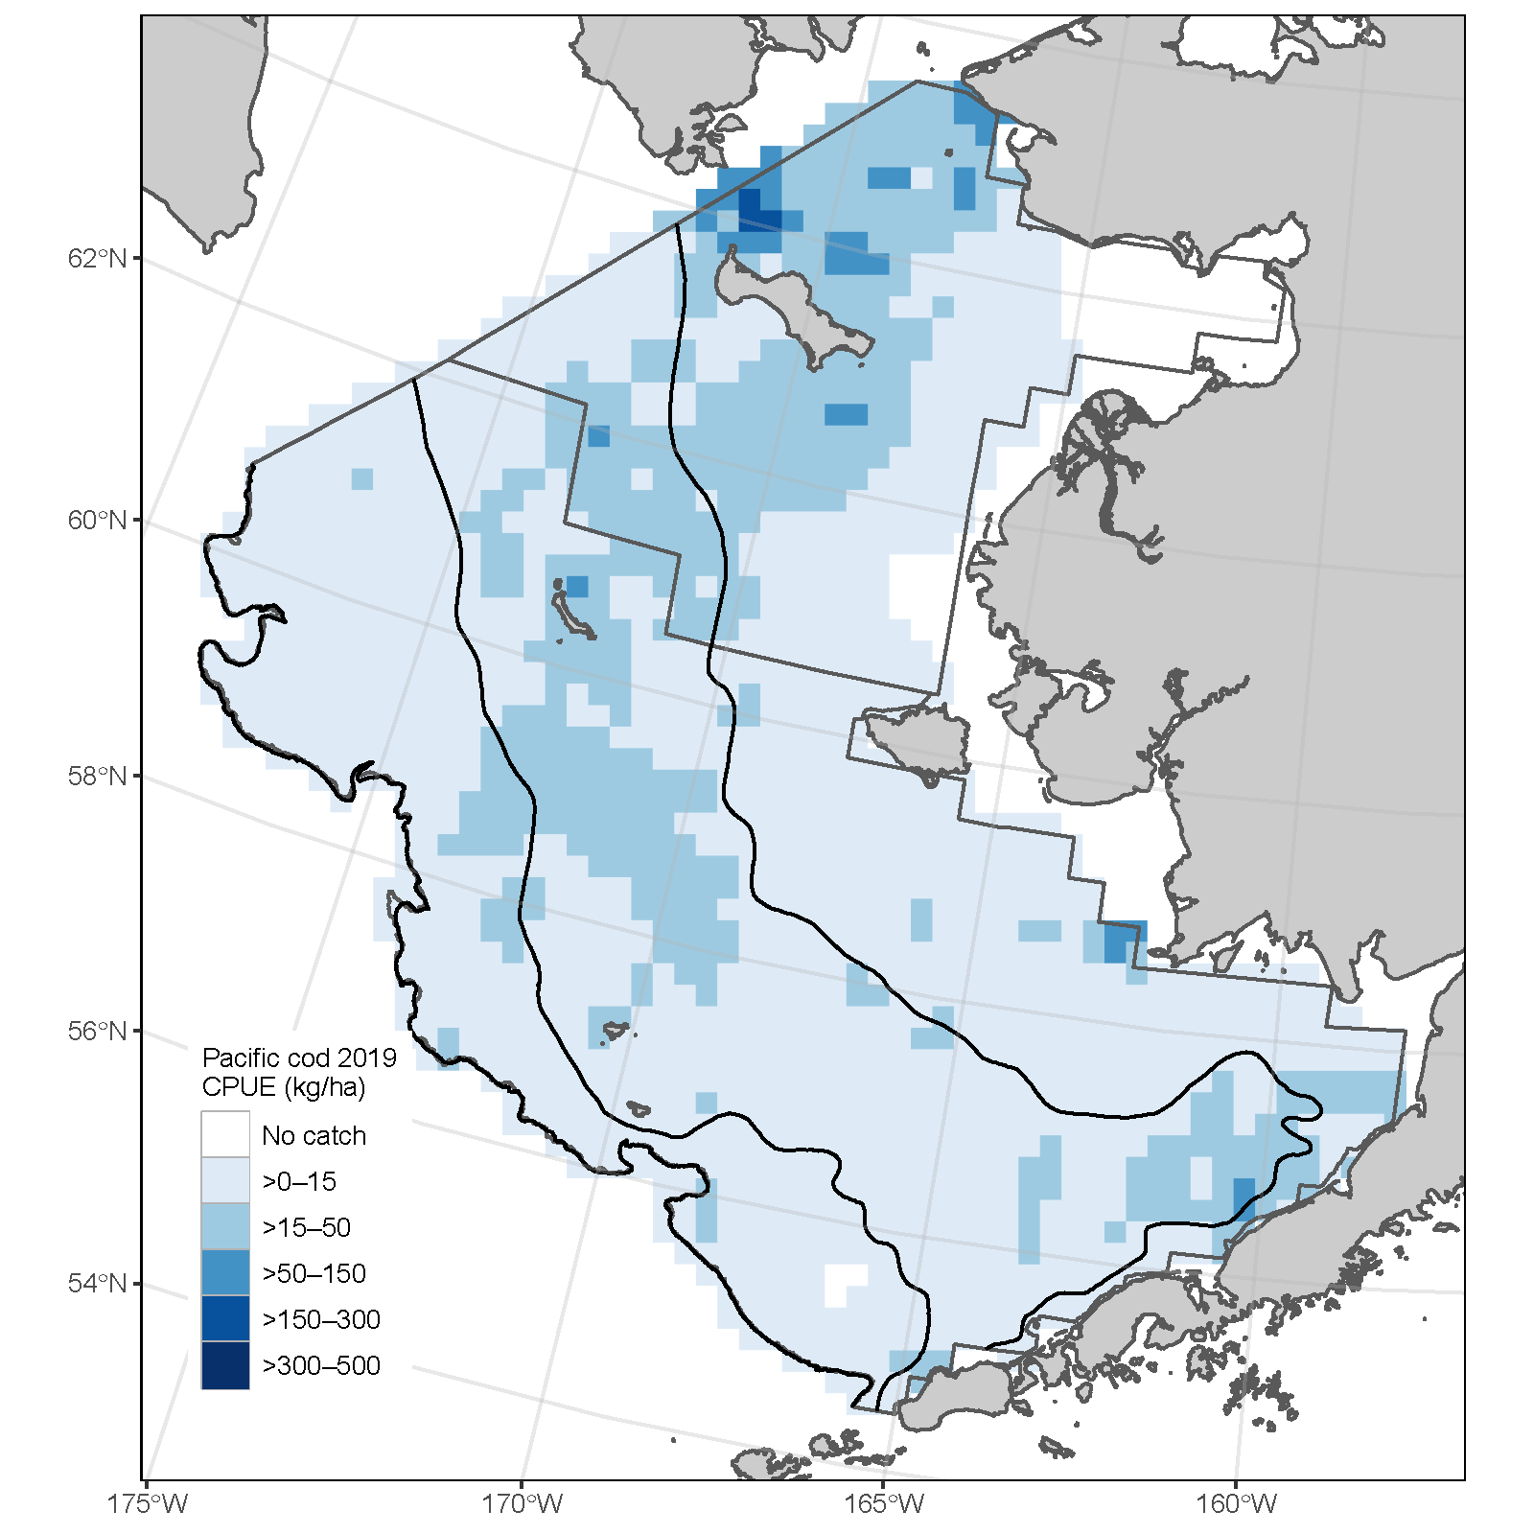
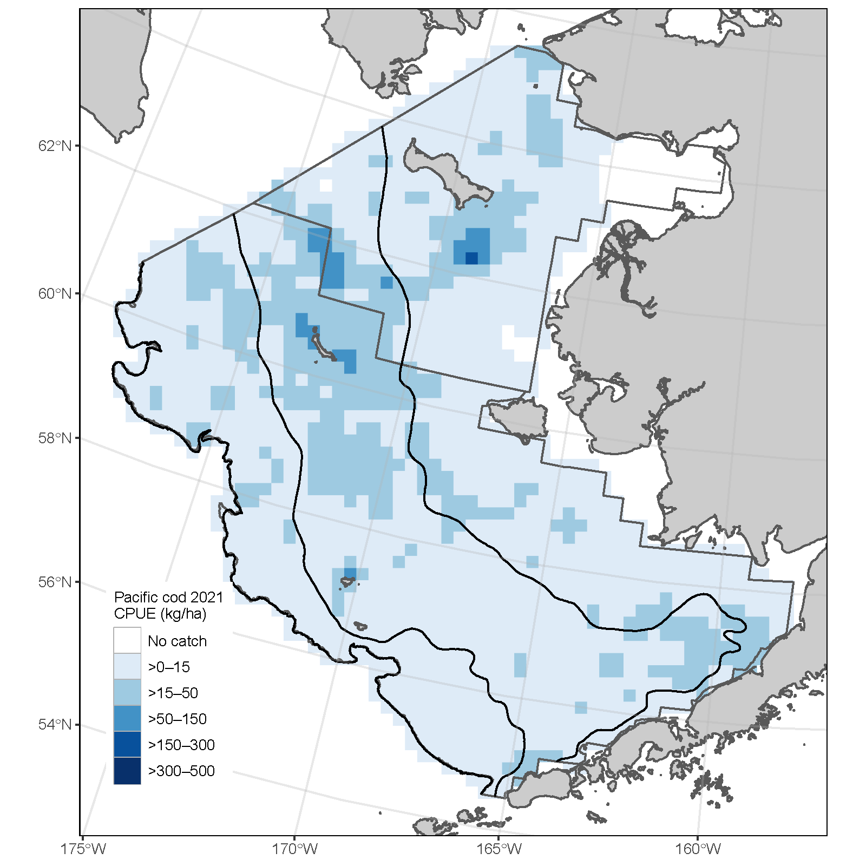
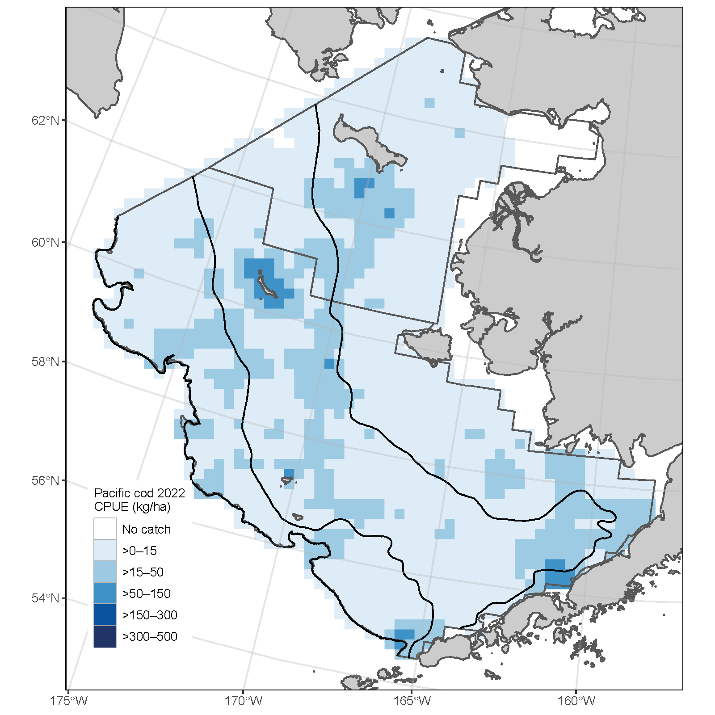
Survey –Bering Sea Shelf Bottom Trawl
2019 2021 2022
Notes:
Time series with highlights of trends and any issues (e.g., survey method changes, data issues), use separate slides for different survey time series, provide regional breakdown time series or spatial distribution maps only if relevant to data interpretation or model evaluation, may include exploratory surveys if relevant to model interpretation, otherwise limit

Slide 14
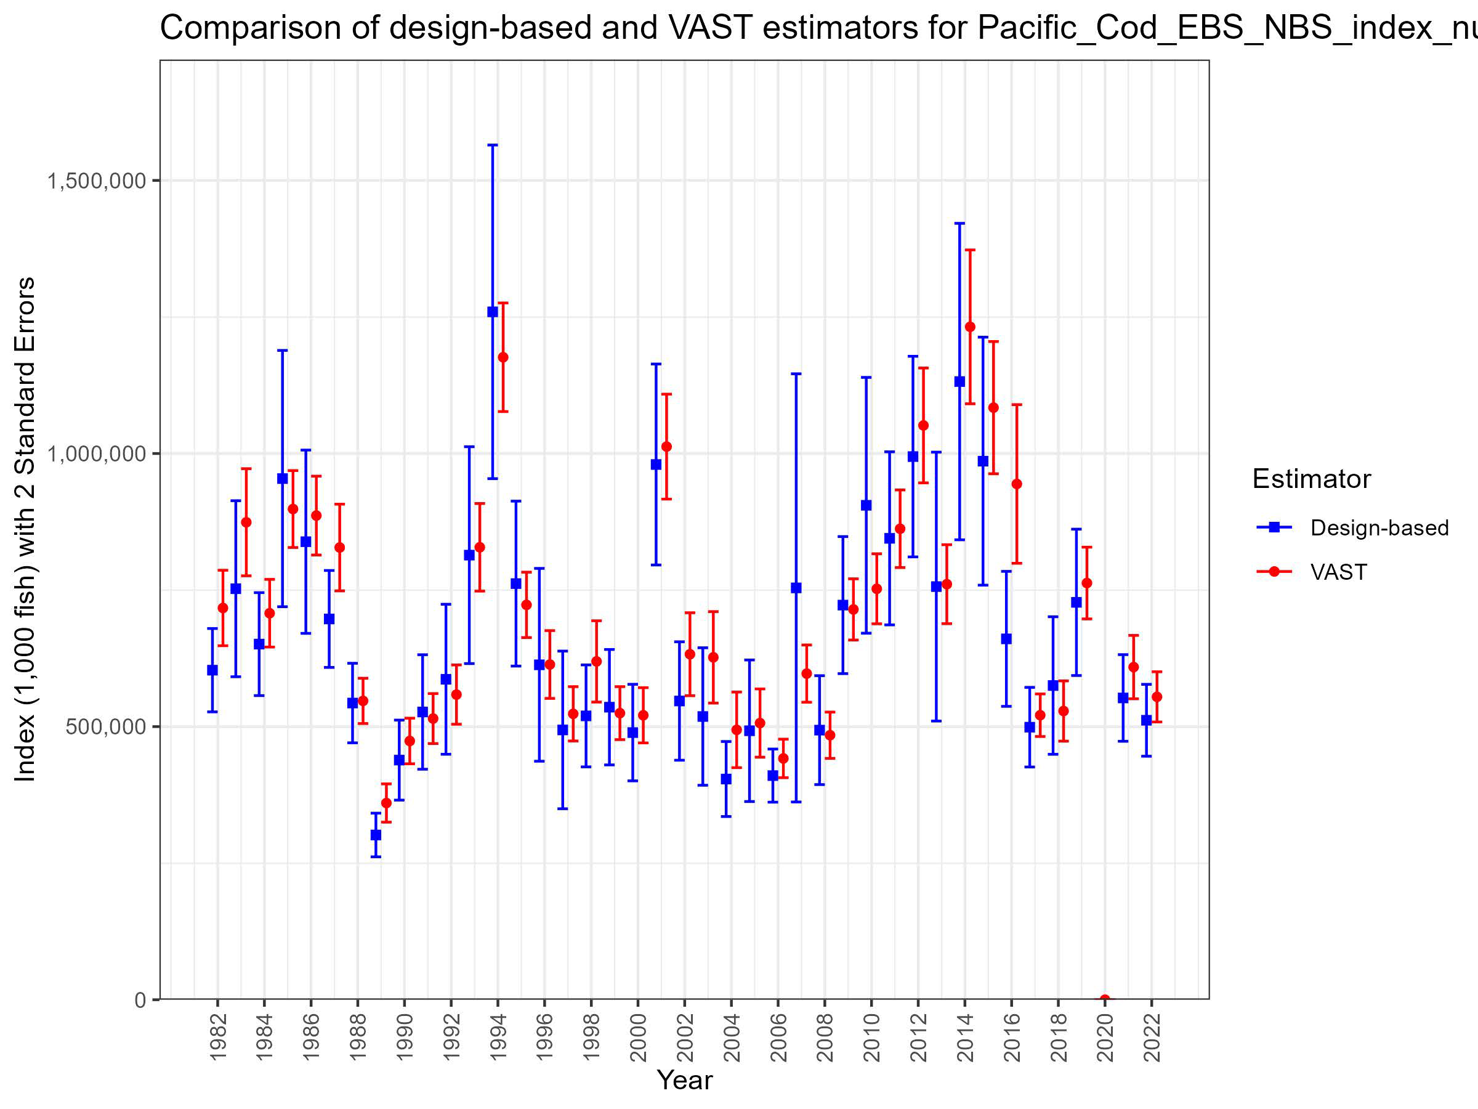
VAST Survey Index – Bering Sea Shelf Bottom Trawl
VAST NBS and EBS bottom trawl survey data
Cold-pool extent index as a covariate
Notes:
Time series with highlights of trends and any issues (e.g., survey method changes, data issues), use separate slides for different survey time series, provide regional breakdown time series or spatial distribution maps only if relevant to data interpretation or model evaluation, may include exploratory surveys if relevant to model interpretation, otherwise limit

Slide 15
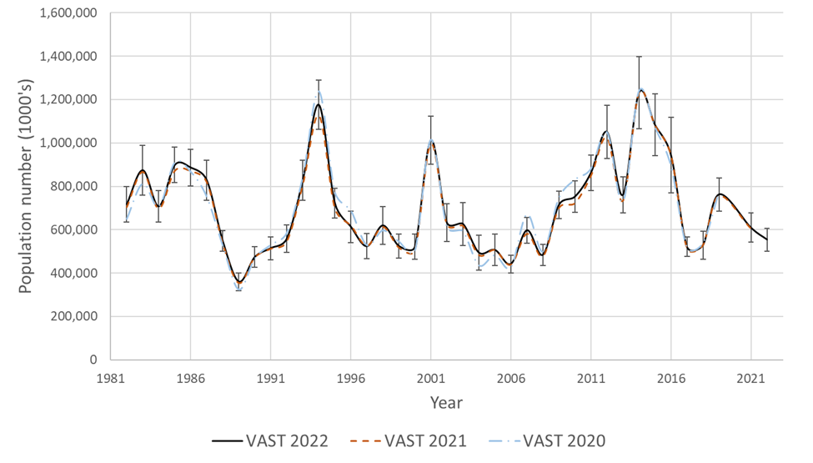
VAST Survey Index – Bering Sea Shelf Bottom Trawl
Small changes in time series from previous years
8.9% decrease in 2022 abundance from 2021
Notes:
Time series with highlights of trends and any issues (e.g., survey method changes, data issues), use separate slides for different survey time series, provide regional breakdown time series or spatial distribution maps only if relevant to data interpretation or model evaluation, may include exploratory surveys if relevant to model interpretation, otherwise limit

Slide 16
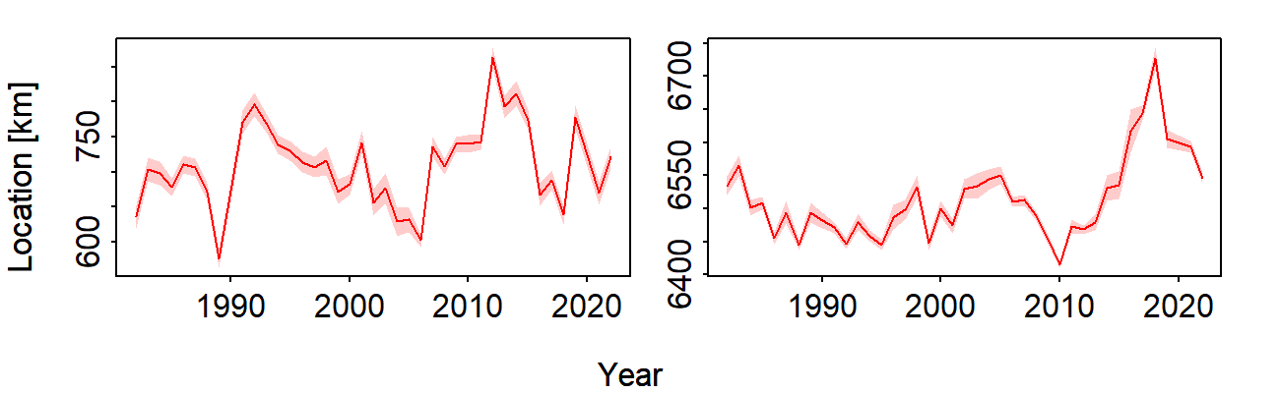
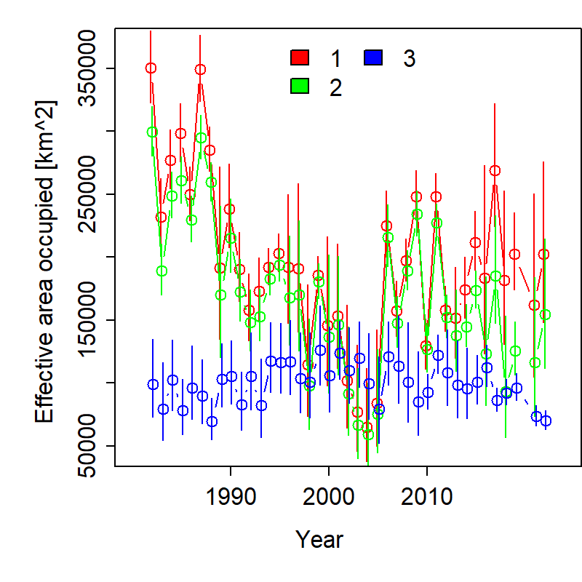
VAST Survey Index – Bering Sea Shelf Bottom Trawl
Eastings (km)
Northings (km)
COG shifted to the southeast since 2021
Overall extent has increased, while decreasing in the NBS since 2021
Notes:
Time series with highlights of trends and any issues (e.g., survey method changes, data issues), use separate slides for different survey time series, provide regional breakdown time series or spatial distribution maps only if relevant to data interpretation or model evaluation, may include exploratory surveys if relevant to model interpretation, otherwise limit

Slide 17
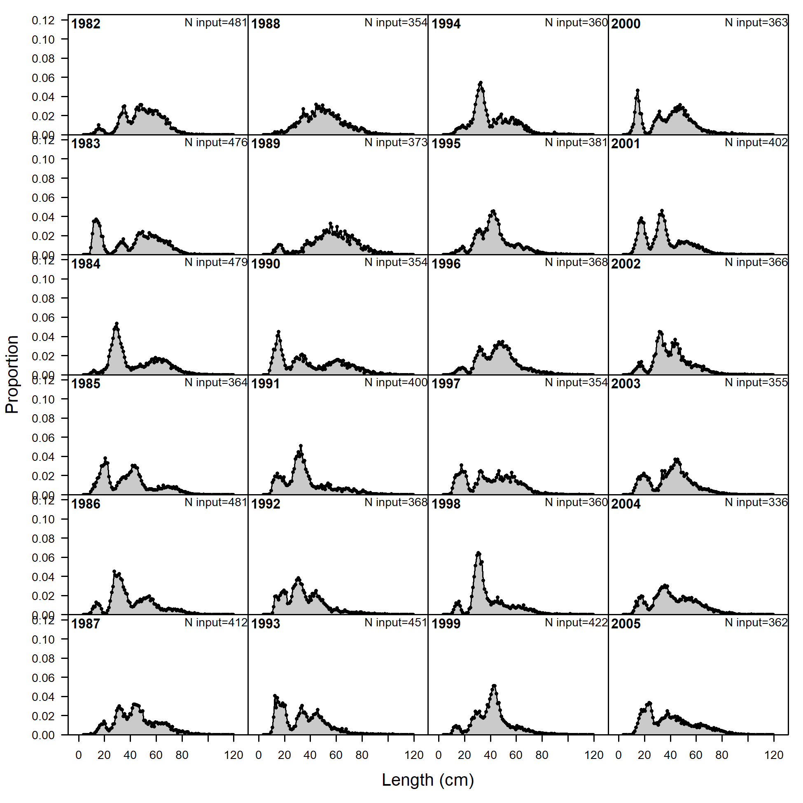
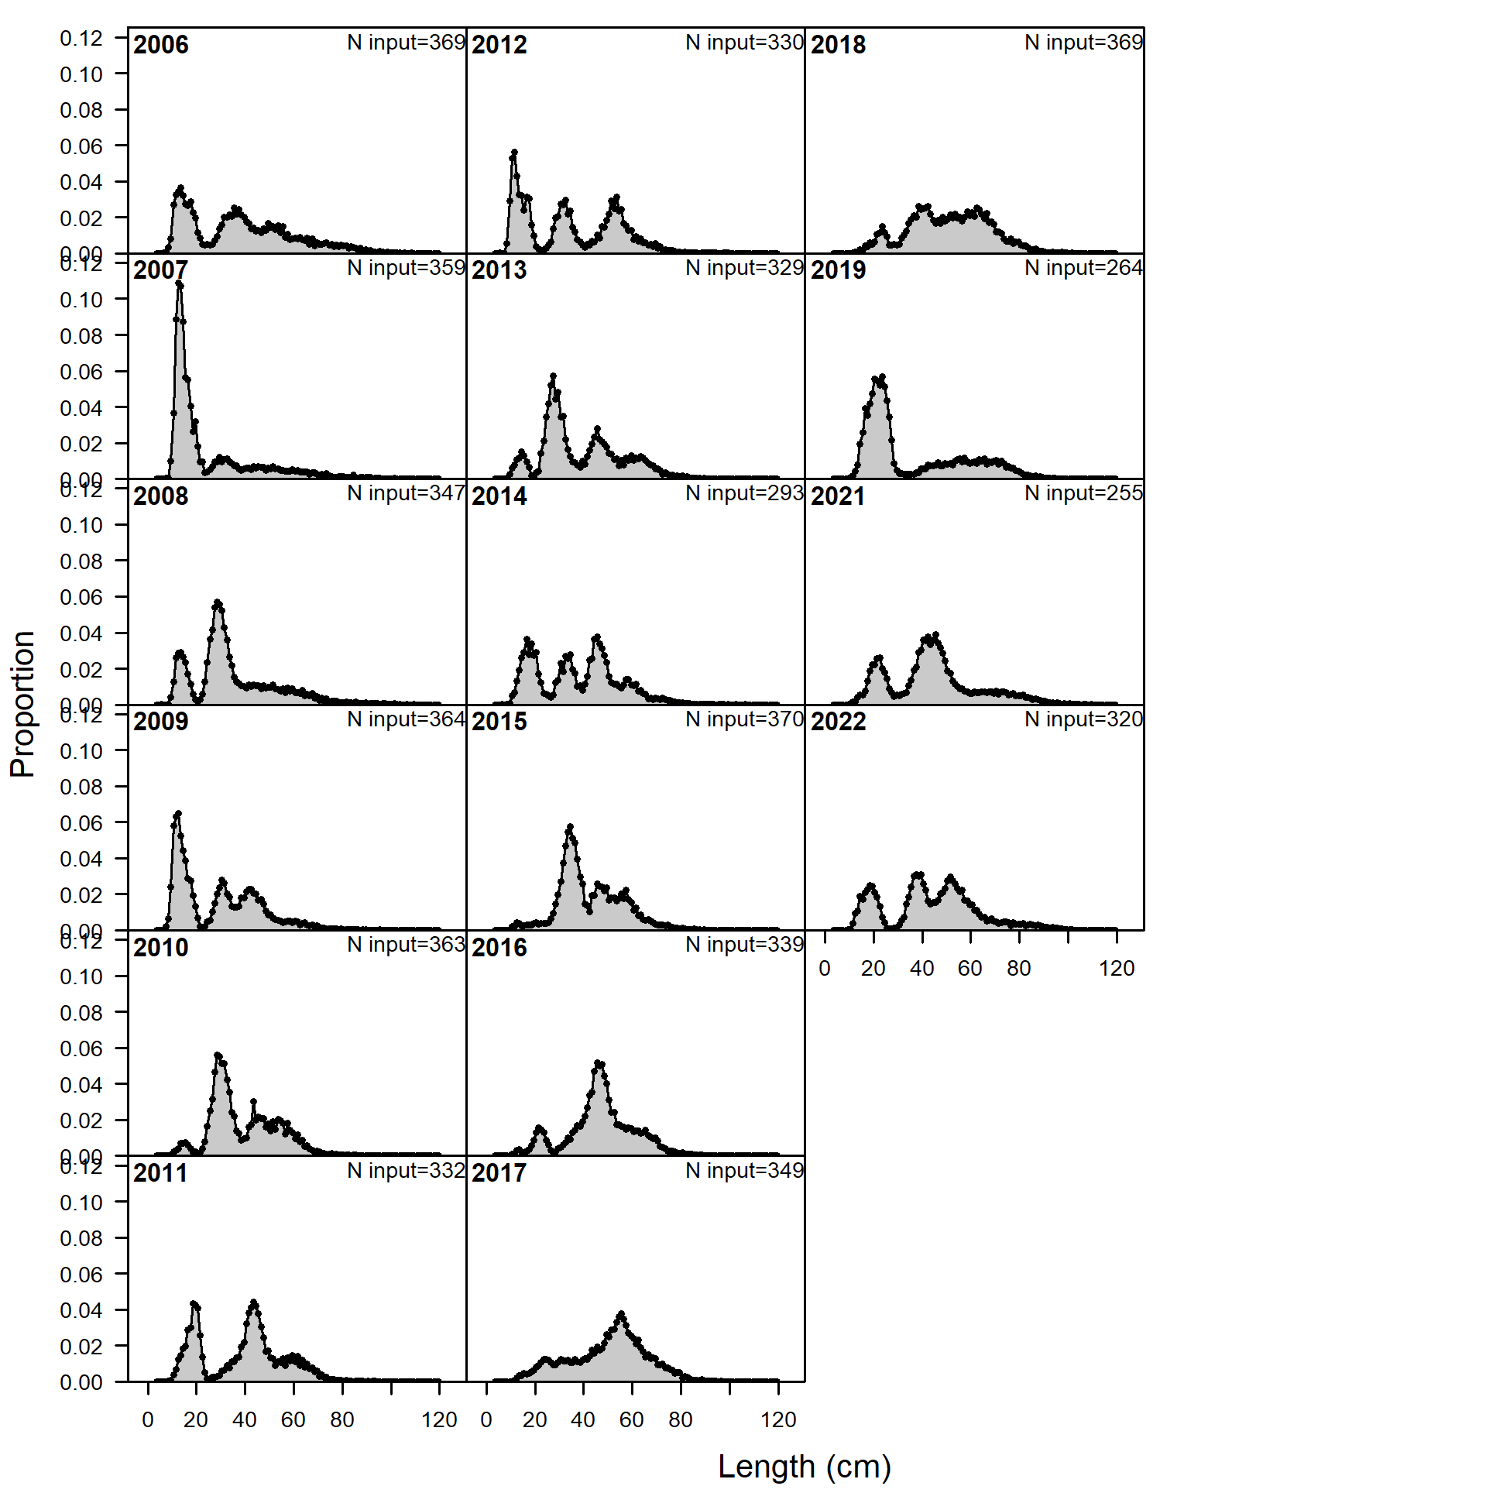
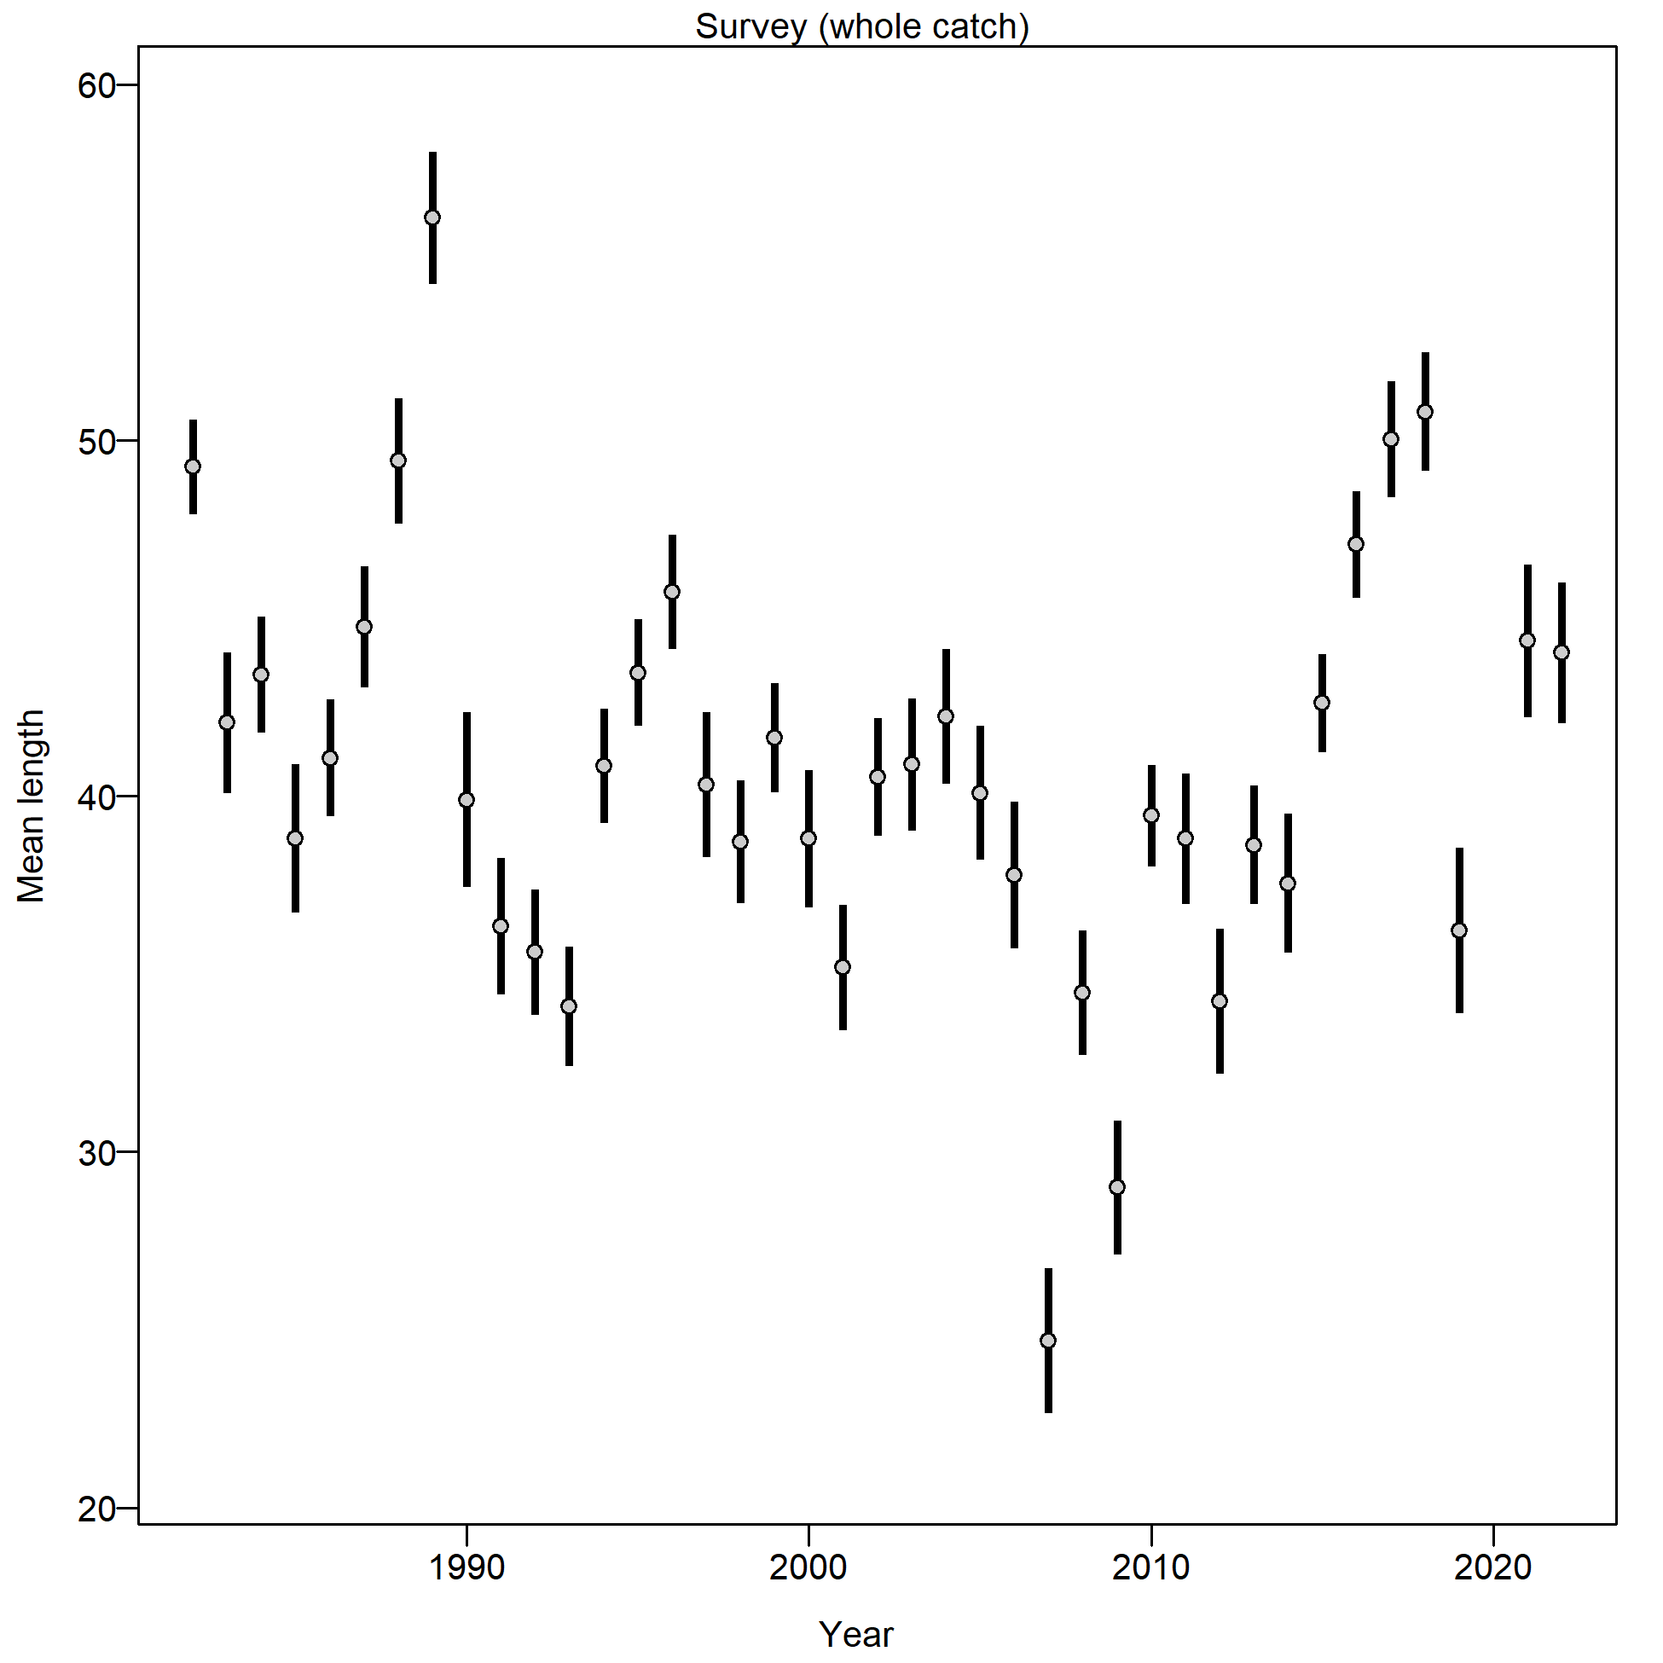
Survey Size Composition - EBS Shelf Bottom Trawl
Notes:
Graphs of age compositions by sex (if relevant) over time followed by size compositions by sex (if relevant) over time with highlights of trends and any issues (e.g., tracking cohorts through time, shifts in size distributions, plus age group)

Slide 18
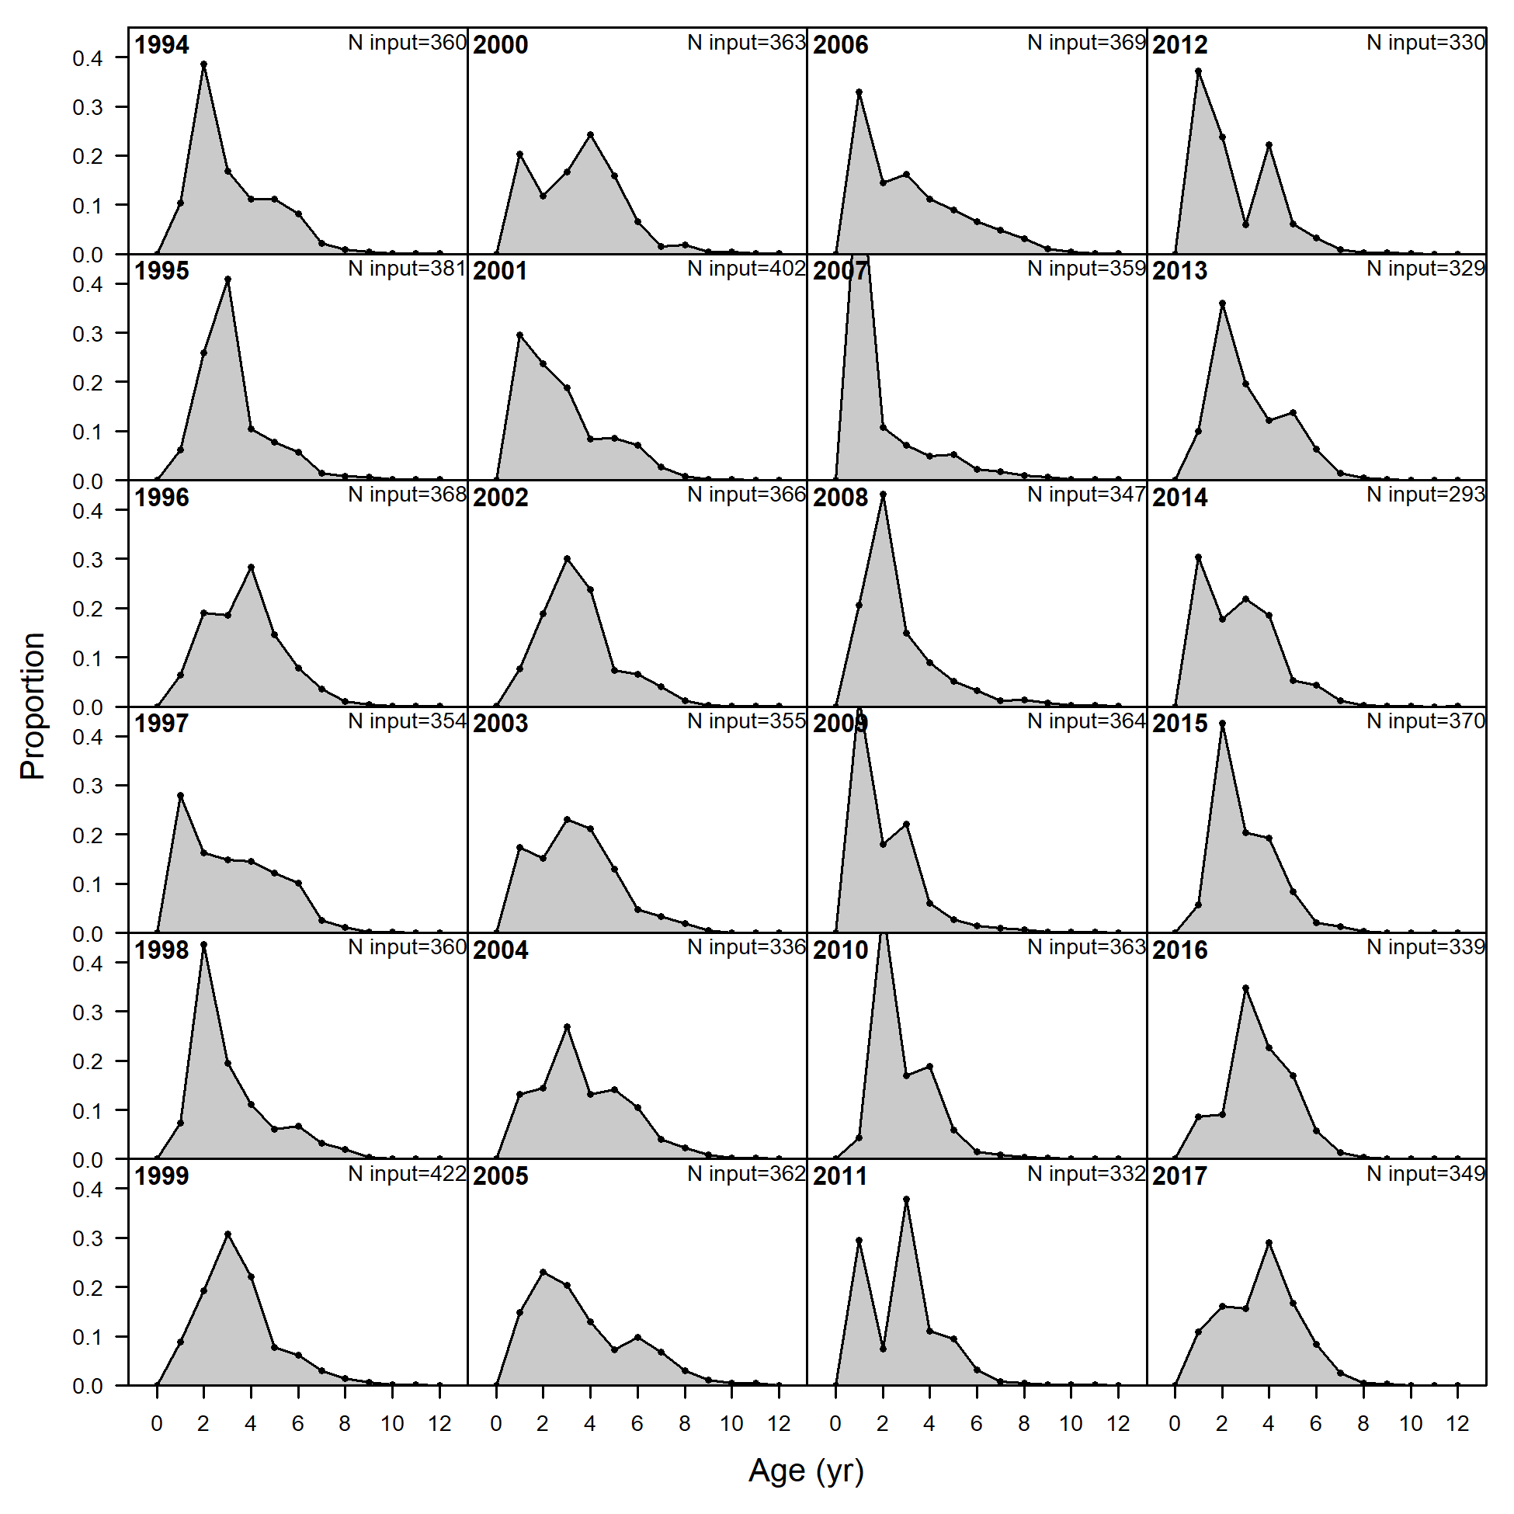
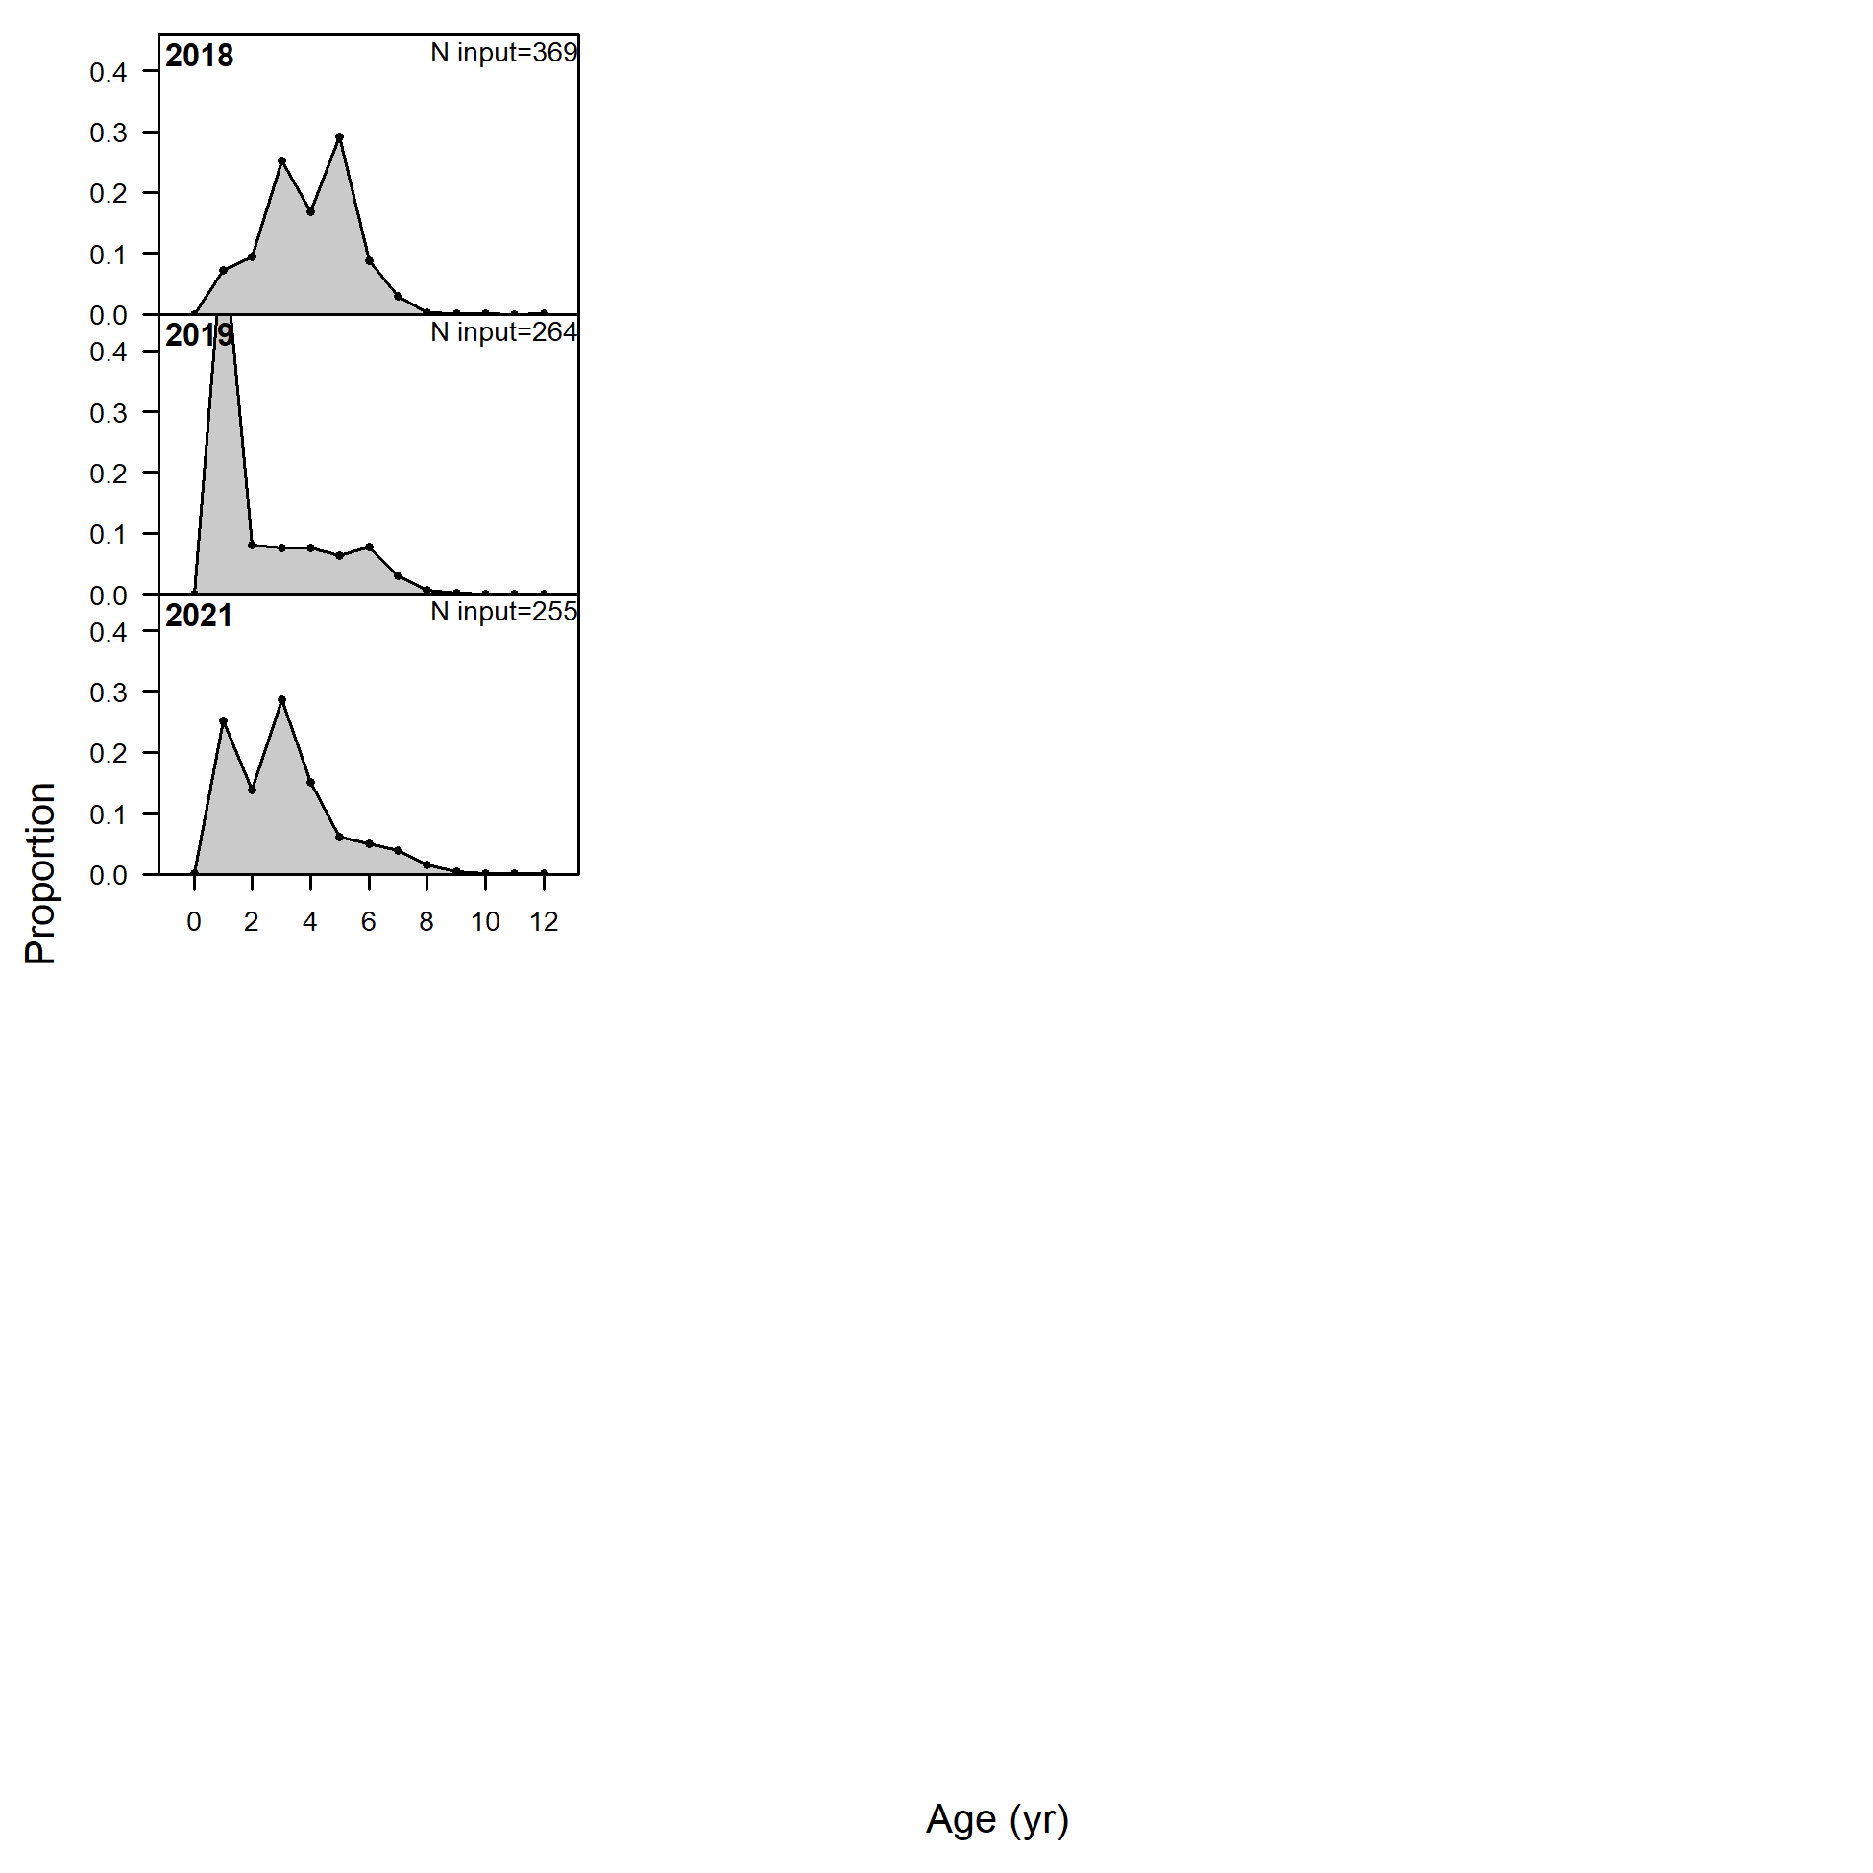
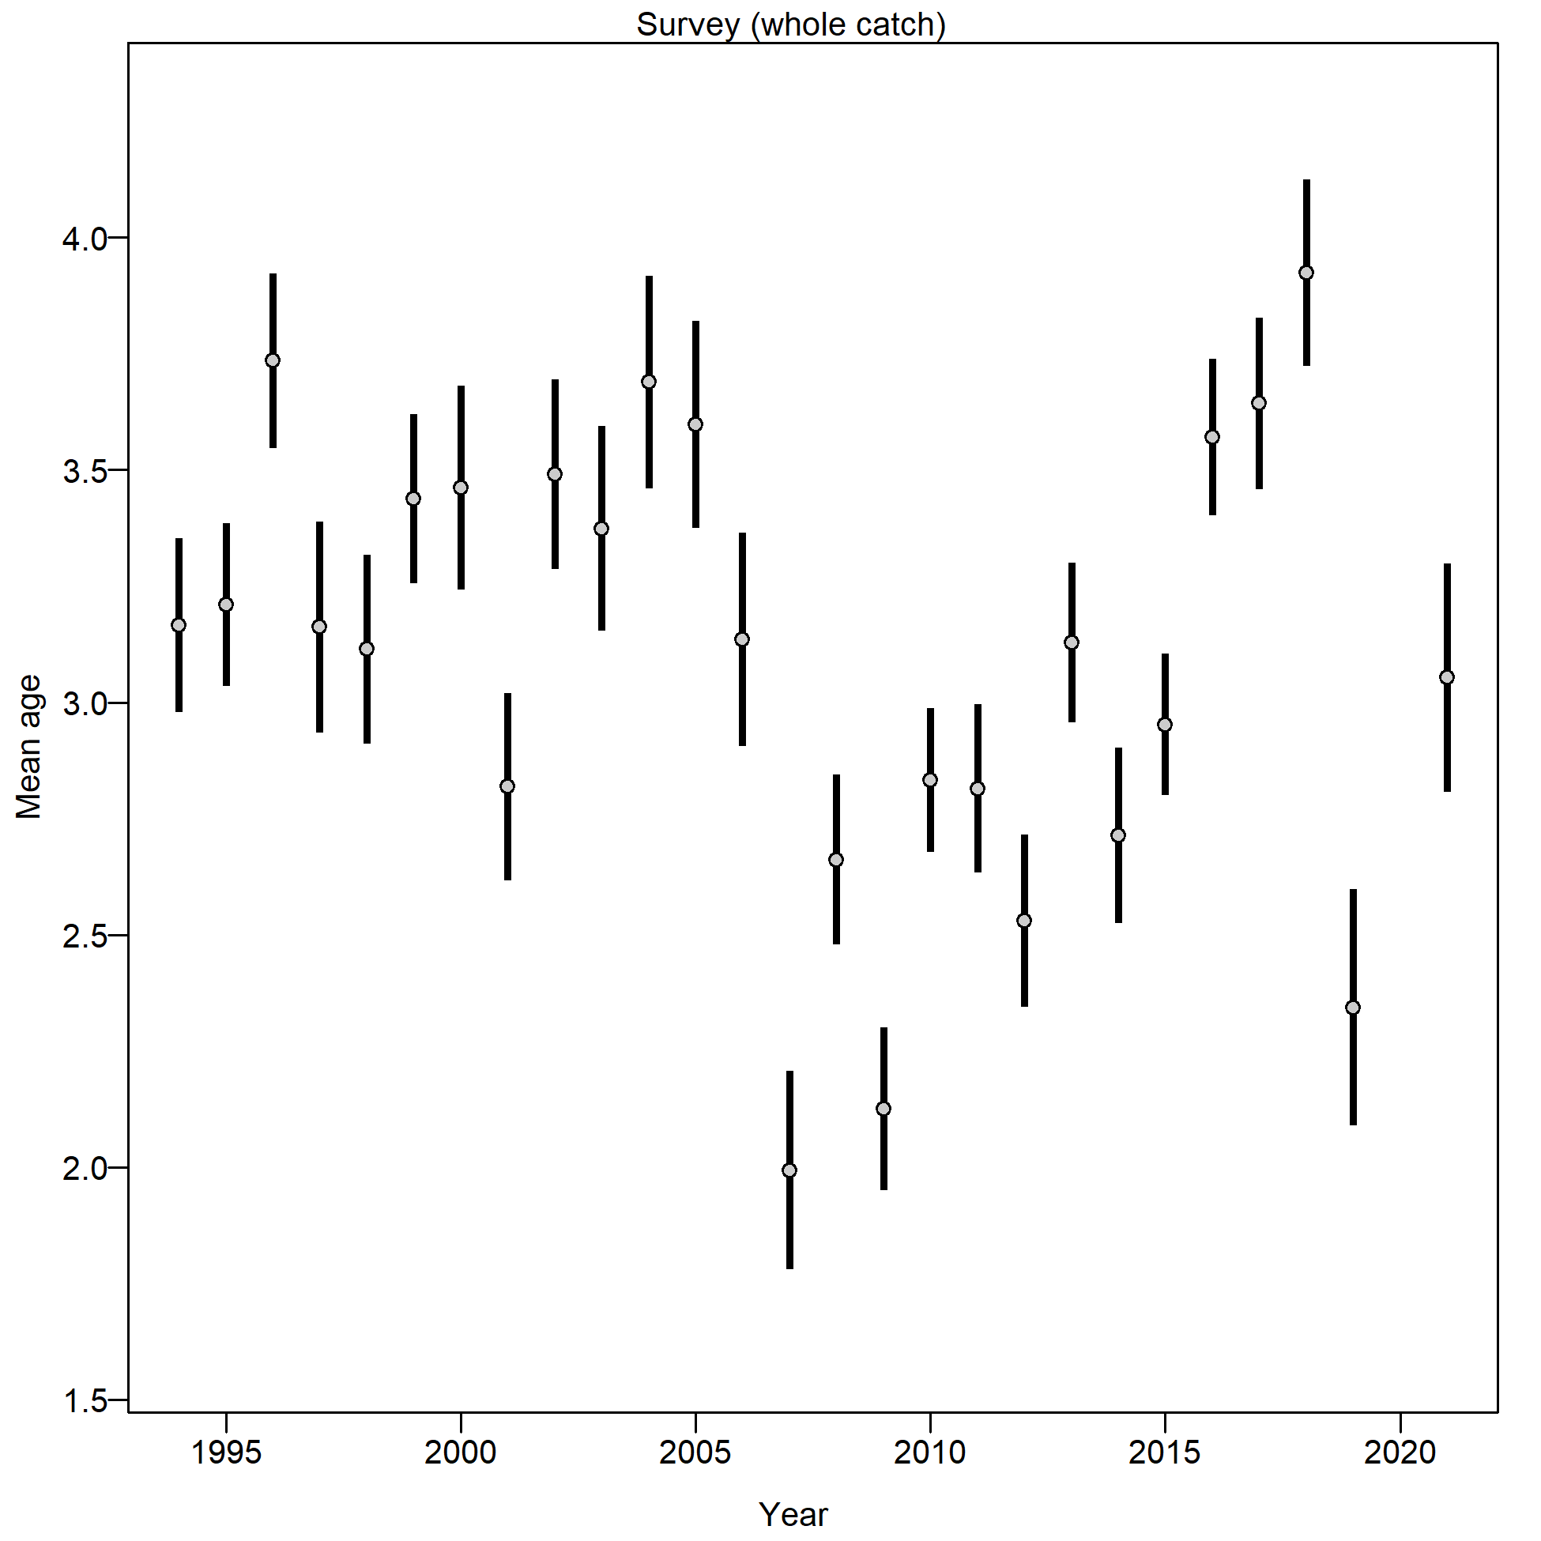
Survey Age Composition - EBS Shelf Bottom Trawl
Notes:
Graphs of age compositions by sex (if relevant) over time followed by size compositions by sex (if relevant) over time with highlights of trends and any issues (e.g., tracking cohorts through time, shifts in size distributions, plus age group)

Slide 19
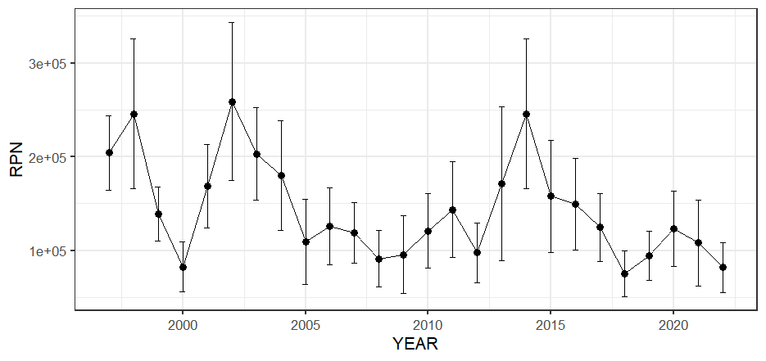
AFSC Longline Survey – Relative population numbers (not used in model)
Limited extent
2022 lowest abundance in series
Notes:
Graphs of age compositions by sex (if relevant) over time followed by size compositions by sex (if relevant) over time with highlights of trends and any issues (e.g., tracking cohorts through time, shifts in size distributions, plus age group)

Slide 20
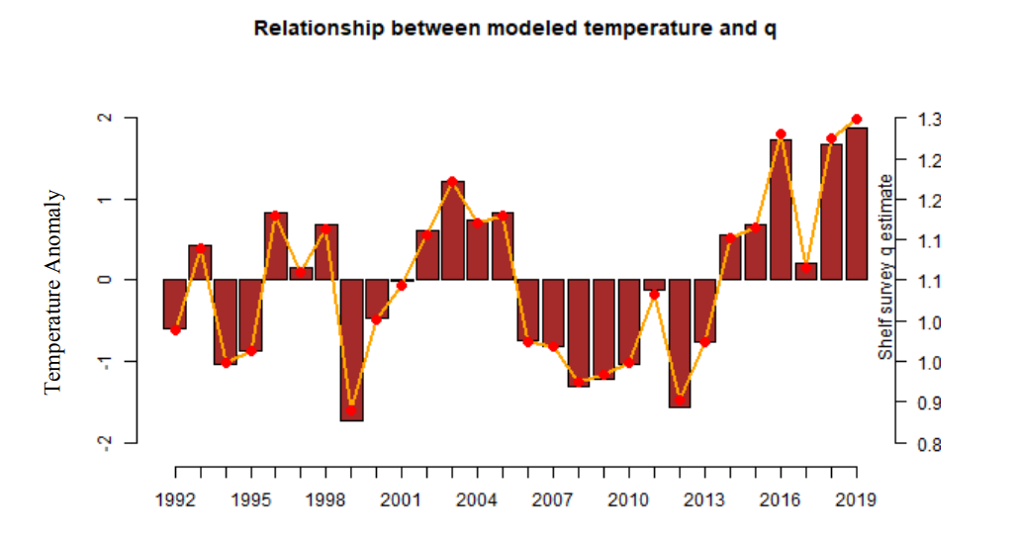
Parameters Estimated Externally
Notes:
List or table with estimates with highlights of trends and any issues (e.g., different natural mortality estimates, changes in maturity)

Slide 21
Parameters Estimated Externally
Notes:
List or table with estimates with highlights of trends and any issues (e.g., different natural mortality estimates, changes in maturity)

Slide 23
Model Summary
No Model Changes
Same model as 2018, see Spies et al. 2018 for more details
Split-sex, age structured model…
Notes:
Table of base model with brief description of features and list of alternative models if relevant, NOTE: do not show models not being evaluated

Slide 24
Model Results
Model Fit
Parameters
Selectivity
Time Series
Retrospective
Phase Plane
Risk Table
Projections
Management
Notes:
Outline list of results section including Model Fit, Parameters, Selectivity, Time Series, Retrospective, Phase Plane, Risk Table, Projections, Management

Slide 25
Model Fit - Catch
Should include graphs of model fit to time series and compositions shown in the Data Summary section, preferably in the same order (e.g., Model Fit - Catch, then Model Fit - Fishery Age Composition,...), may include convergence or goodness of fit statistics, if evaluating multiple models show fit of all models evaluated for time series and compositions, highlight any lack of fit, may provide likelihood comparison table
Notes:
Should include graphs of model fit to time series and compositions shown in the Data Summary section, preferably in the same order (e.g., Model Fit - Catch, then Model Fit - Fishery Age Composition,...), may include convergence or goodness of fit statistics, if evaluating multiple models show fit of all models evaluated for time series and compositions, highlight any lack of fit, may provide likelihood comparison table

Slide 26
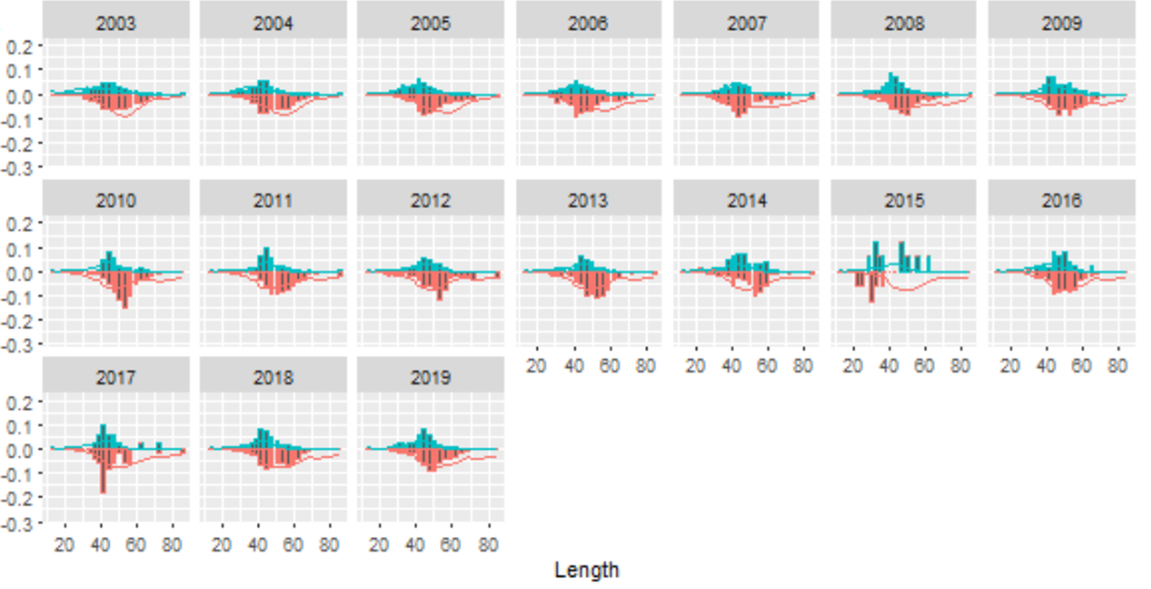
Model Fit - Fishery Size Composition
Notes:
Should include graphs of model fit to time series and compositions shown in the Data Summary section, preferably in the same order (e.g., Model Fit - Catch, then Model Fit - Fishery Age Composition,...), may include convergence or goodness of fit statistics, if evaluating multiple models show fit of all models evaluated for time series and compositions, highlight any lack of fit, may provide likelihood comparison table

Slide 27
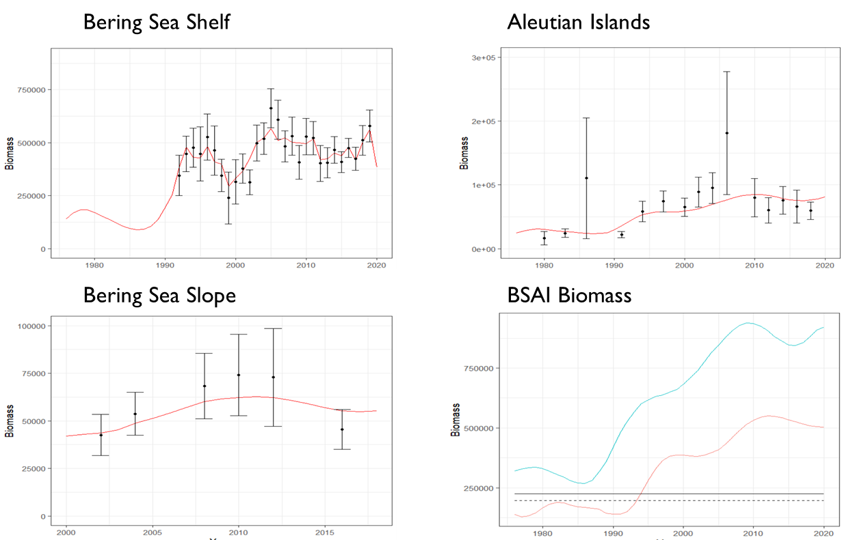
Model Fit - Survey Biomass
Notes:
Should include graphs of model fit to time series and compositions shown in the Data Summary section, preferably in the same order (e.g., Model Fit - Catch, then Model Fit - Fishery Age Composition,...), may include convergence or goodness of fit statistics, if evaluating multiple models show fit of all models evaluated for time series and compositions, highlight any lack of fit, may provide likelihood comparison table

Slide 28
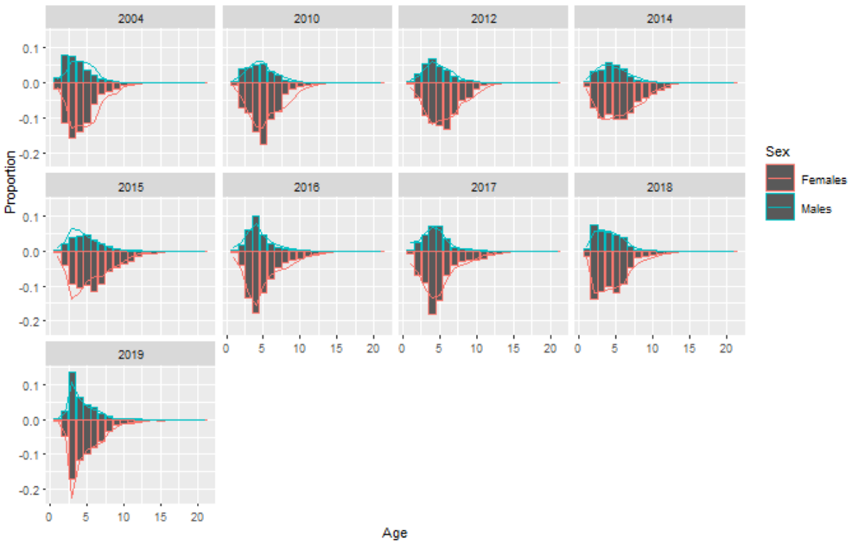
Model Fit - Survey Age Composition - EBS Shelf Survey
Notes:
Should include graphs of model fit to time series and compositions shown in the Data Summary section, preferably in the same order (e.g., Model Fit - Catch, then Model Fit - Fishery Age Composition,...), may include convergence or goodness of fit statistics, if evaluating multiple models show fit of all models evaluated for time series and compositions, highlight any lack of fit, may provide likelihood comparison table

Slide 29
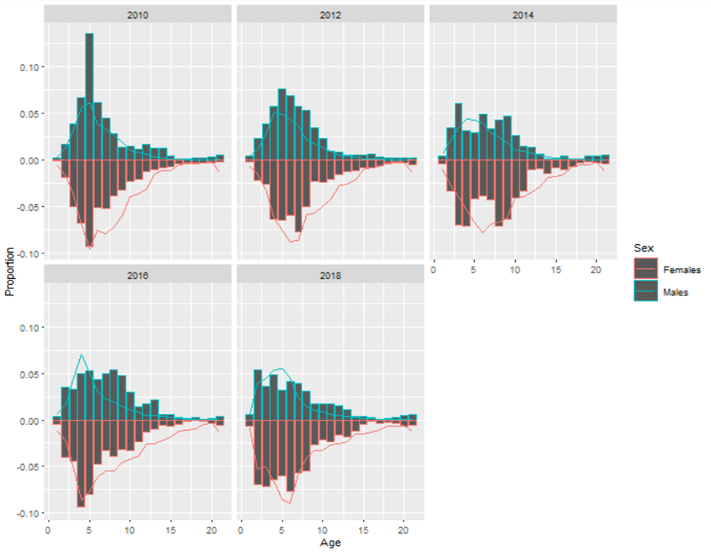
Model Fit - Survey Age Composition - AI Survey
Notes:
Should include graphs of model fit to time series and compositions shown in the Data Summary section, preferably in the same order (e.g., Model Fit - Catch, then Model Fit - Fishery Age Composition,...), may include convergence or goodness of fit statistics, if evaluating multiple models show fit of all models evaluated for time series and compositions, highlight any lack of fit, may provide likelihood comparison table

Slide 30
Parameters
Comparison table of main estimated parameters with uncertainty estimates, if evaluating multiple models provide parameter estimates for all models evaluated, highlight author recommended model
Notes:
Comparison table of main estimated parameters with uncertainty estimates, if evaluating multiple models provide parameter estimates for all models evaluated, highlight author recommended model

Slide 31
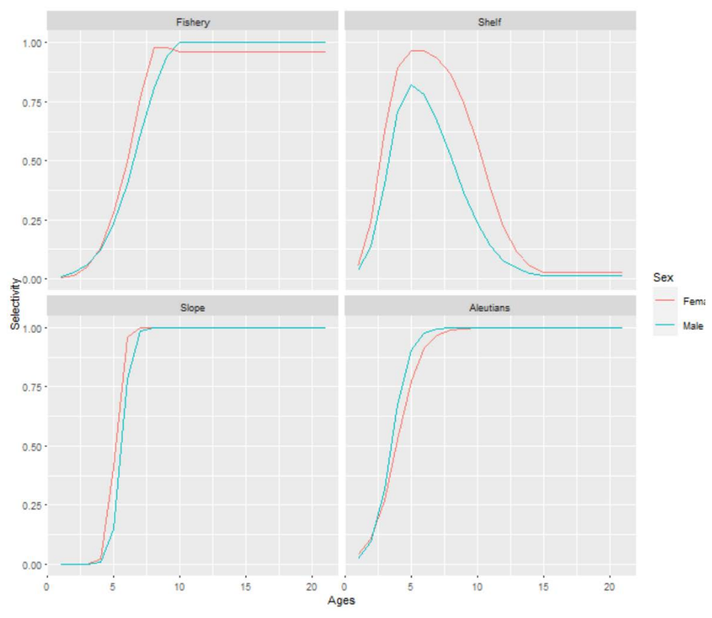
Selectivity
Notes:
Graphs of estimated selectivity curves (e.g., fishery, survey, maturity), if evaluating multiple models include selectivity curves for all models evaluated on same graph if possible, highlight author recommended model

Slide 32
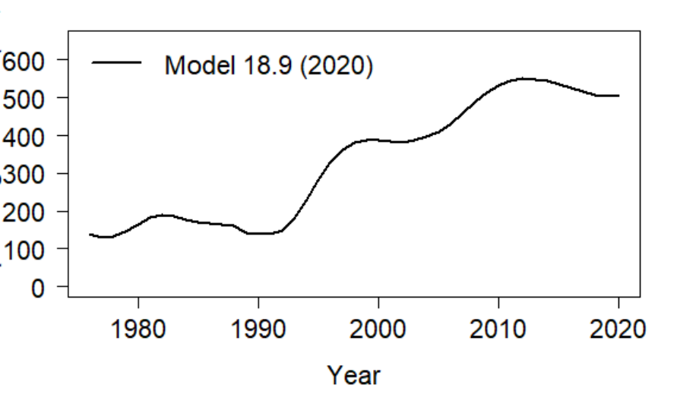
Time Series - Spawning Stock Biomass
Notes:
Graph to include at minimum estimates of Spawning Stock Biomass, Total Biomass, Recruitment, Fishing Mortality (e.g., Time Series - Spawning Stock Biomass), if evaluating multiple models include time series for all models evaluated on same graph, highlight author recommended model

Slide 33
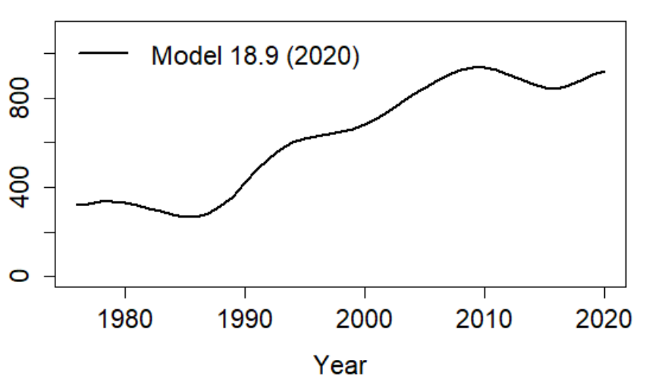
Time Series - Total Biomass
Notes:
Graph to include at minimum estimates of Spawning Stock Biomass, Total Biomass, Recruitment, Fishing Mortality (e.g., Time Series - Spawning Stock Biomass), if evaluating multiple models include time series for all models evaluated on same graph, highlight author recommended model

Slide 34
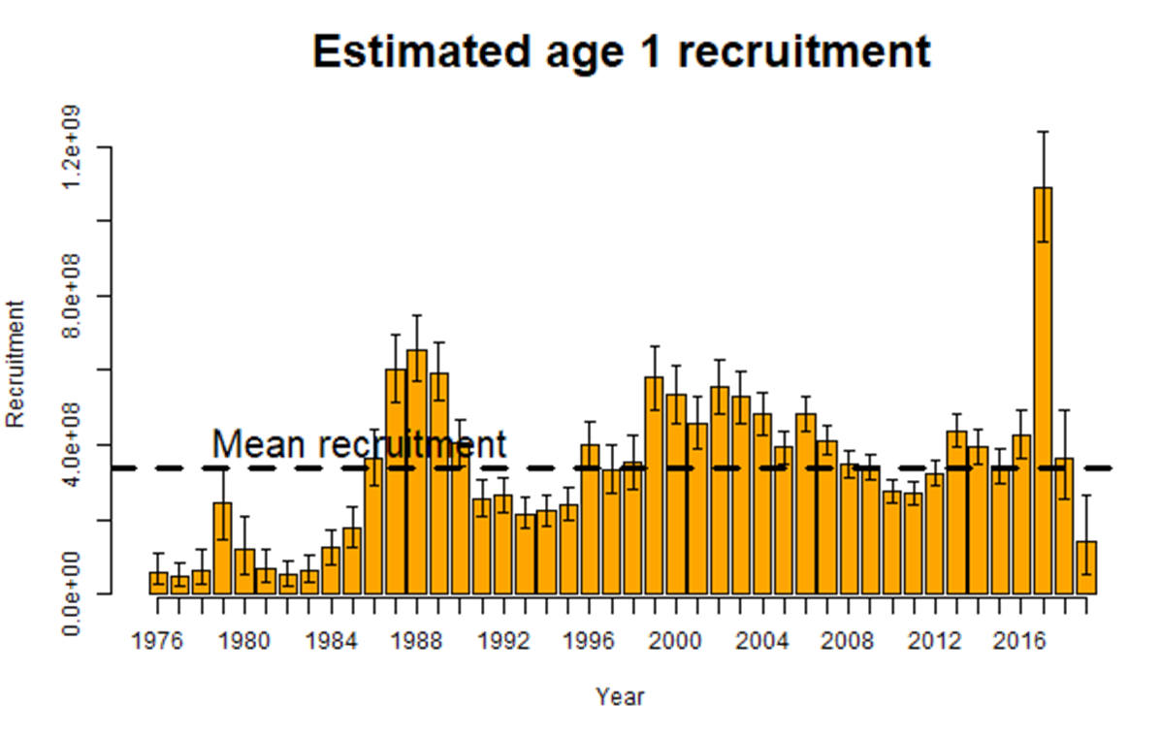
Time Series - Recruitment
Notes:
Graph to include at minimum estimates of Spawning Stock Biomass, Total Biomass, Recruitment, Fishing Mortality (e.g., Time Series - Spawning Stock Biomass), if evaluating multiple models include time series for all models evaluated on same graph, highlight author recommended model

Slide 35
Time Series - Fishing Mortality
Graph to include at minimum estimates of Spawning Stock Biomass, Total Biomass, Recruitment, Fishing Mortality (e.g., Time Series - Spawning Stock Biomass), if evaluating multiple models include time series for all models evaluated on same graph, highlight author recommended model
Notes:
Graph to include at minimum estimates of Spawning Stock Biomass, Total Biomass, Recruitment, Fishing Mortality (e.g., Time Series - Spawning Stock Biomass), if evaluating multiple models include time series for all models evaluated on same graph, highlight author recommended model

Slide 36
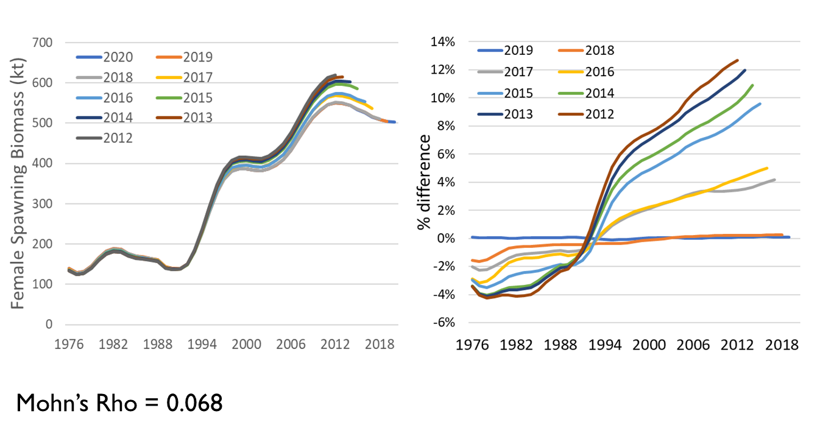
Retrospective
Notes:
Graph of 10 year peel with Mohns rho estimate, if evaluating multiple models include retrospective graph and Mohns rho estimate for base and author recommended model

Slide 37
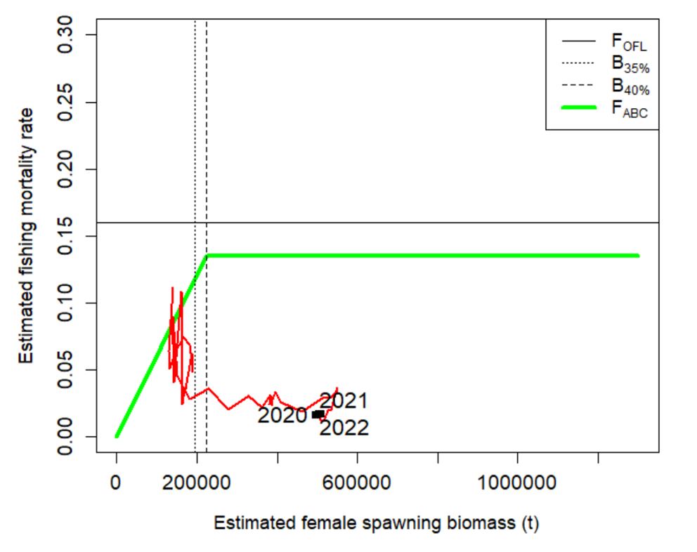
Phase Plane
Notes:
Plot of fishing mortality rate relative to F35% and female spawning biomass relative for B 35% for status

Slide 38
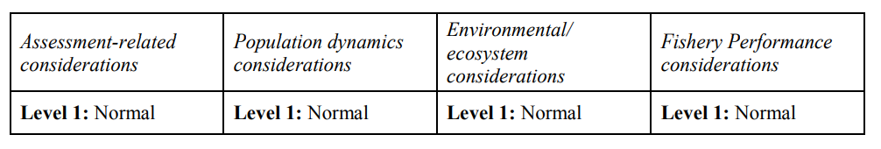
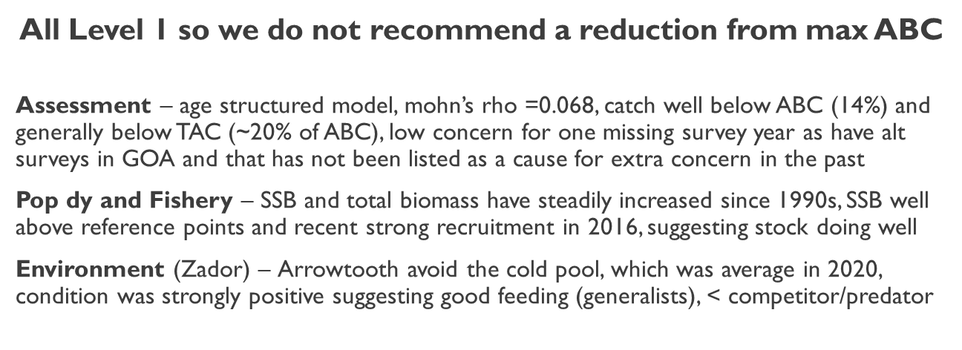
Risk Table
Notes:
Summary table with brief summary of justification text or plots for selected levels of risk, if have ESP for stock and presentation preceding then can simply reference ESP graphs

Slide 39
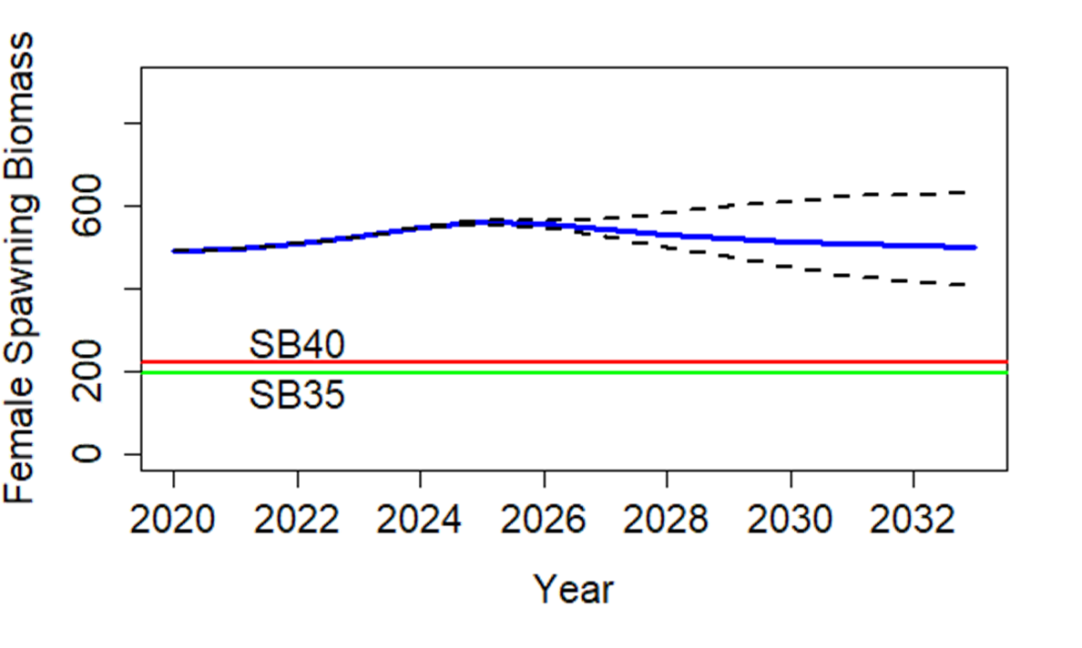
Projection
Notes:
Model graph of Spawning Stock Biomass with B40% and B35% reference lines

Slide 40
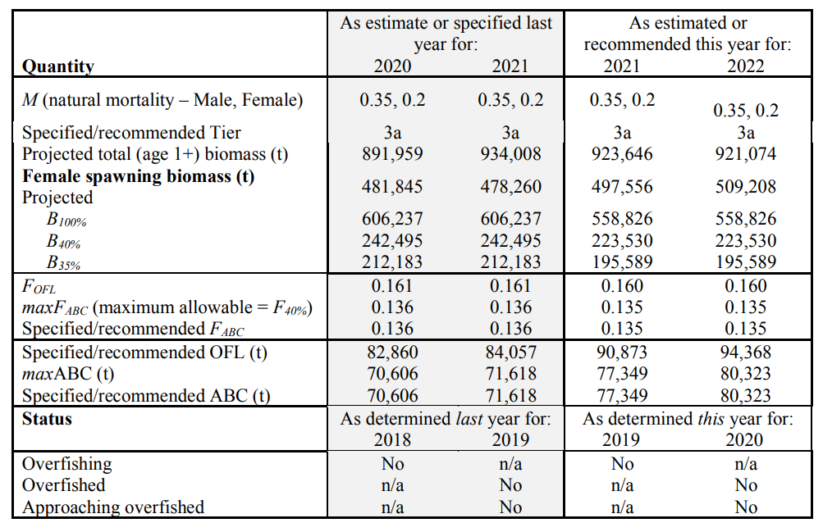
Harvest Recommendation
Notes:
Summary table with last year and recommendation for this year values, highlight ABC and OFL

Slide 41
Apportionment
Table where applicable, including random effects model graphs and final appointment table
Notes:
Table where applicable, including random effects model graphs and final apportionment table

Slide 42
Appendices
List with brief description, if relevant to decision of model provide highlights
Notes:
List with brief description, if relevant to decision of model provide highlights

Slide 43
Conclusions
Recommendation
No model changes, data correction to use fishery sizes from start of observer program with minimum level of samples (300)
Leveling out of biomass after long period of increase from low stock size, possible new year class emerging, surveys show average to increase
No reduction recommended: ABC = … t, OFL = … t
Data Gaps and Future Research Priorities
Consider exploring incorporating estimates of predation mortality from recent EBS CEATTLE model (K. Holsman), include efforts to streamline data pulls and processing between single and multi-species models
Re-examine growth assumptions, update age-length conversion matrices, consider alternative surveys and VAST estimates
Notes:
List of final recommendations with any relevant data gaps and research priorities

Slide 44
Plan Team Summary
Table filled out using author recommended model
Notes:
Table filled out using author recommended model

Slide 45
Discussion
May include list of action questions if applicable for the Teams deliberation
Notes:
May include list of action questions if applicable for the Teams deliberation

Slide 46

QUESTIONS?
CONTACTS:
KALEI.SHOTWELL@NOAA.GOV

Slide 47

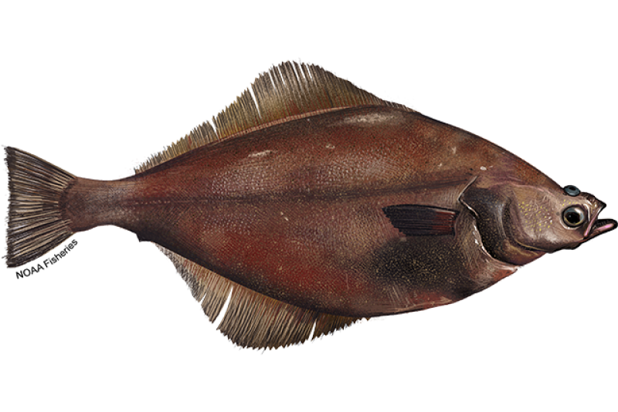
Supplemental Slides for BSAI Plan Team

